Slide 2
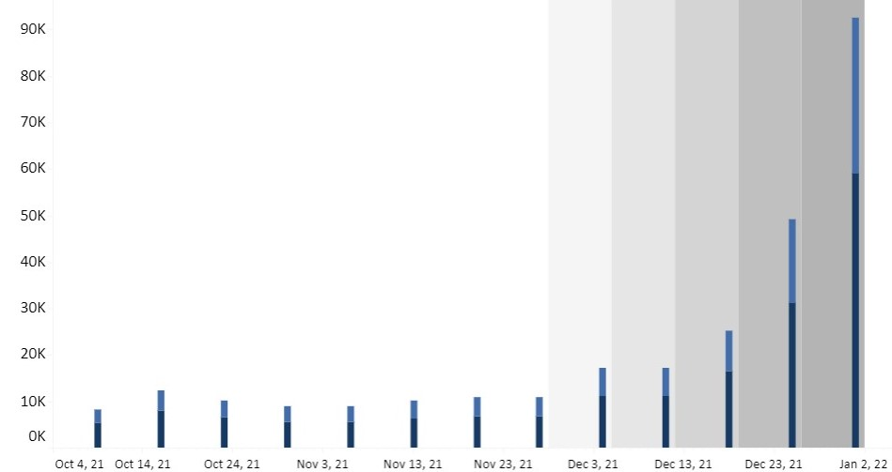
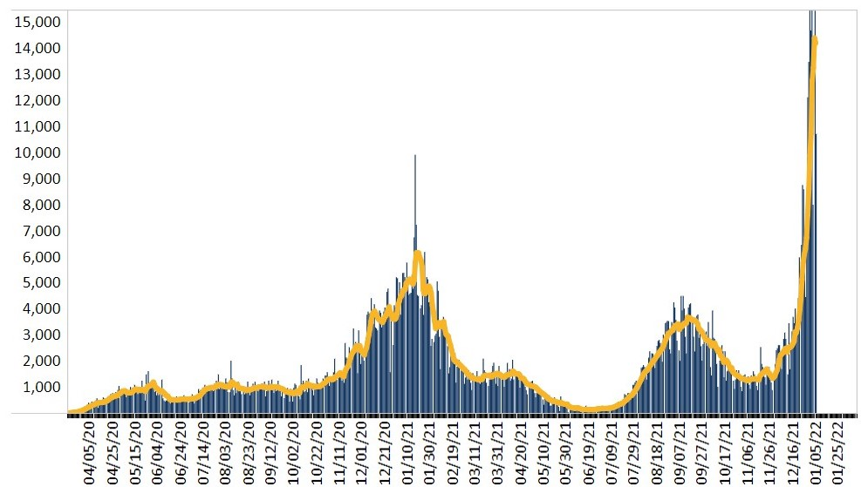
Virginia: Cases, Hospitalizations, and Deaths
Updated 1/5/22
Cases by Date of Symptom Onset, Past 13 weeks
Cases by Date Reported, All Reporting Timeline
Gray shaded area illness may not have been reported yet
*VDH received cumulative death data on 12/28 totaling 185 deaths
Source: Cases – Coronavirus (virginia.gov), Cases and Deaths - Coronavirus (virginia.gov), VHHA Hospitalizations – Coronavirus (virginia.gov), Data represent a 7-day moving average
Notes:
Compared to last week, cases increased to 14,212 (7-day MA) from 7,613 per day (+86.7%)
131% higher than the January peak of 2021
285% higher than the September high of 2021
Hospitalizations increased to 2,479 per day (+34.4%)
*Deaths decreased to 25 confirmed deaths last week (-57%)
Cases – Coronavirus (virginia.gov) - Graphs
Cases and Deaths by Date Reported – Coronavirus (virginia.gov)) – Total Cases by Date Reported, Deaths by Date Reported
VHHA Hospitalizations – Coronavirus (virginia.gov) - Hospitalizations
2021 Jan peak: 6166
2021 June low: 129
2021 September 3689
In Virginia, compared to last week, we saw increase in total cases by 40.5%
Hospitalizations increased by 13.7%
Deaths decreased by 6.1%

Slide 3
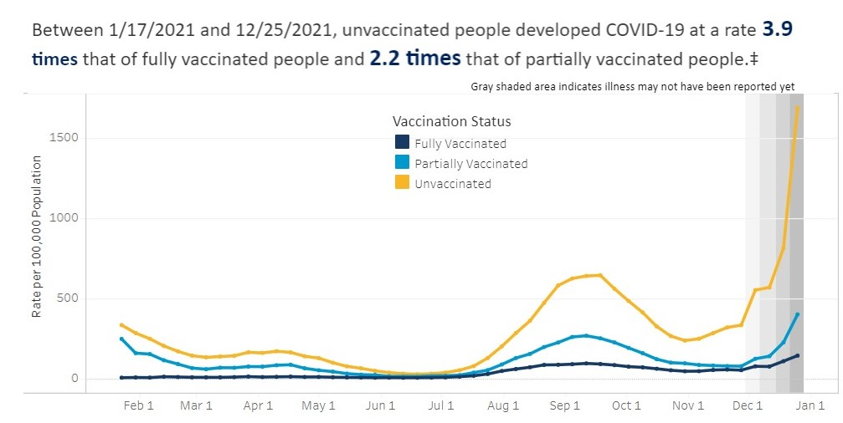
Virginia: Rate of Hospitalizations Per 100,000 by Vaccine Status (1/17/21-12/25/21)
Updated 1/5/22
Source: VDH Hospitalizations by Vaccine Status

Slide 4
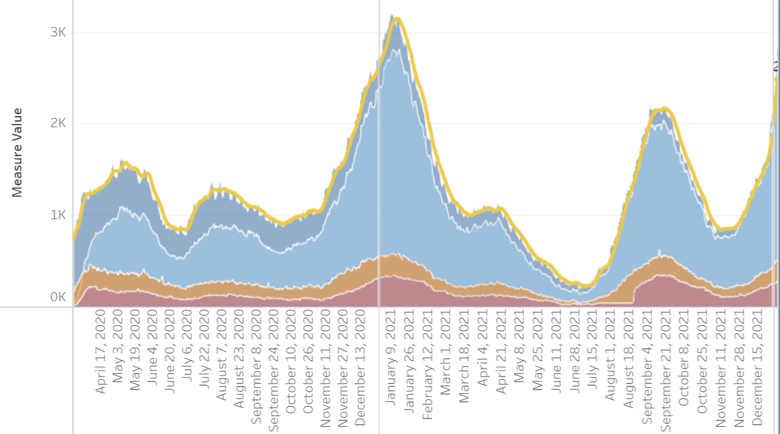
Virginia Hospitalization Trends
Updated 1/5/22
Source: VHHA Hospitalizations - Coronavirus (virginia.gov)
Notes:
Compared to last week hospitalizations increased to 2,479 (7-day MA) from 1,650 (+34%)
14% higher than the September high of 2021
Compared to last week, ICU hospitalizations have increased to 499 from 412 (+21%)
280 patients are currently on ventilator support
20% lower than the September high of 2021
Hospitalizations (7 day MA)
Sept High: 2167
Ventilator Support
Sept High: 352
January 2021 High 350

Slide 5
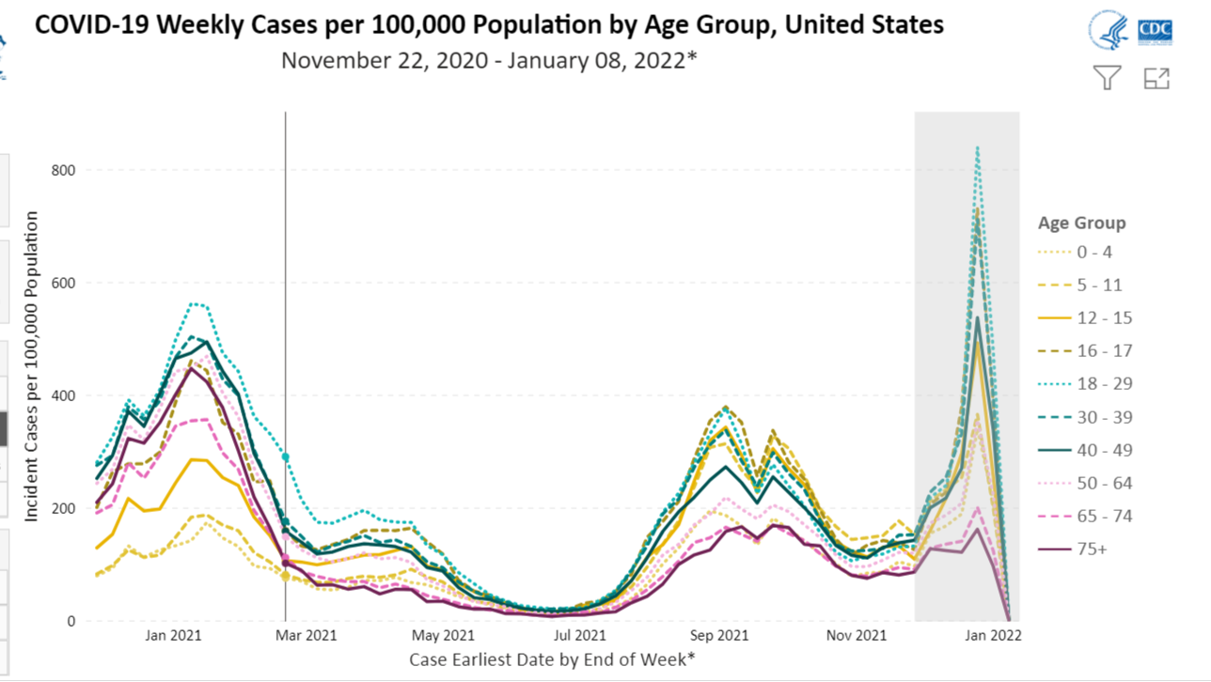
Data
Notes:
Hospialization data:
“while children still have the lowest rate of hospitalization of any group, pediatric hospitalizations are at the highest rate compared to any prior point in the pandemic.”
“It is noteworthy, however, that many children are hospitalized with [COVID-19] as opposed to because of [COVID-19], reflecting the high degree of penetrance of infection among the pediatric population,” leading infectious disease expert Anthony Fauci said during a press briefing last week.
Nationally, the number of hospitalized young children infected with COVID-19 rose last week to the highest levels since the pandemic began.
The increases were observed in children 4 and younger; the data did include children admitted to hospitals for reasons other than COVID
More than 4/100K children ages 4 and younger hospitalized were infected with COVID-19 as of January 1- double the rate a month ago, and about three times the rate since last year.
Only 0.6/100K of hospitalized children ages 5-11yo were infected,

Slide 6
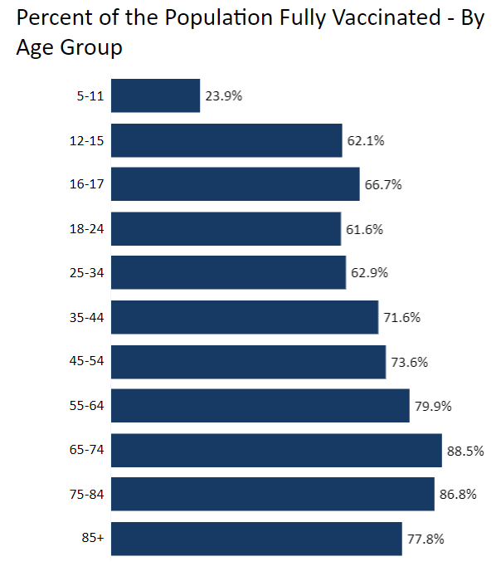

Slide 7
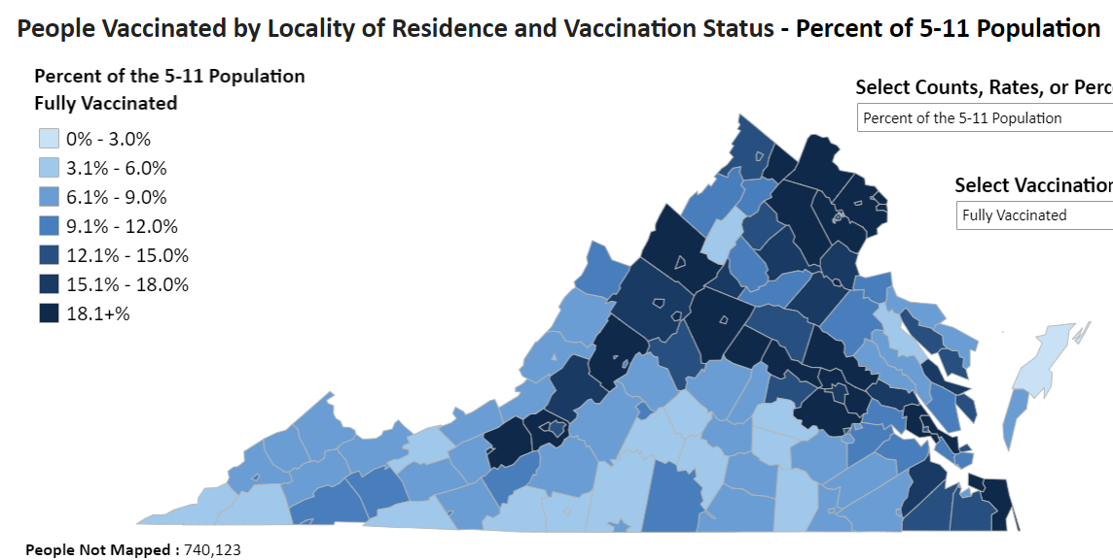

Slide 8
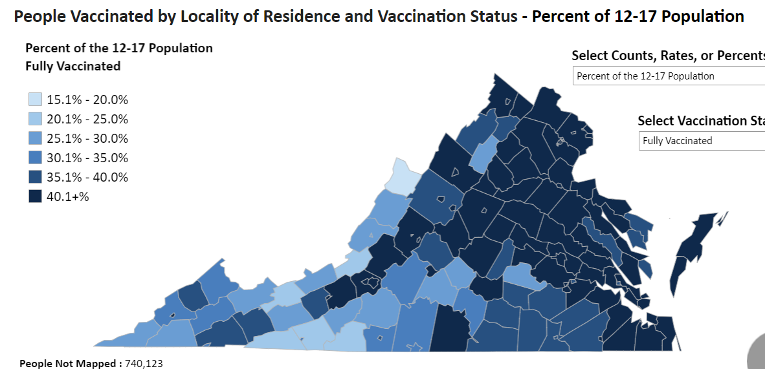

Slide 9
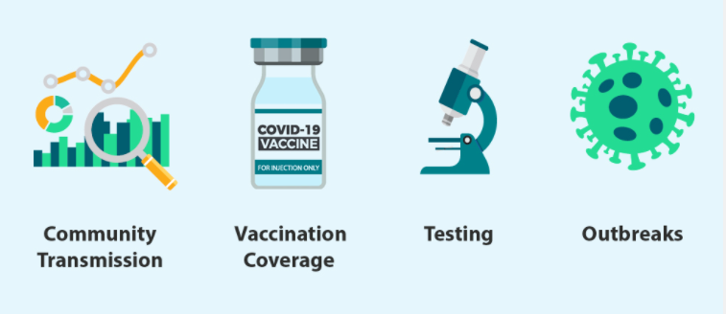
CDC Guidance for K12 Schools: Key Messages
Students benefit from in-person learning, and safely returning to in-person instruction continues to be a priority.
Vaccination is the leading public health prevention strategy to end the COVID-19 pandemic.
CDC recommends universal indoor masking by all* students (ages 2 years and older), staff, teachers, and visitors to K-12 schools, regardless of vaccination status.
Reduced the recommended time for isolation and quarantine periods to five days. For details see CDC’s page on Quarantine and Isolation.
In addition to universal indoor masking, CDC recommends schools maintain at least 3 feet of physical distance between students within classrooms as feasible.
Students, teachers, and staff should stay home when they have signs of any infectious illness and be referred to their healthcare provider for testing and care.
Implement layered prevention strategies
Monitor community transmission, vaccination coverage, screening testing, and occurrence of outbreaks
Notes:
Students benefit from in-person learning, and safely returning to in-person instruction continues to be a priority.
Screening testing, ventilation, handwashing and respiratory etiquette, staying home when sick and getting tested, contact tracing in combination with quarantine and isolation, and cleaning and disinfection are also important layers of prevention to keep schools safe.
When it is not possible to maintain a physical distance of at least 3 feet, such as when schools cannot fully re-open while maintaining these distances, it is especially important to layer multiple prevention strategies, such as screening testing.
Implement layered prevention strategies to protect students, teachers, staff, visitors, and other members of their households and support in-person learning.
Monitor community transmission, vaccination coverage, screening testing, and occurrence of outbreaks to guide decisions on the level of layered prevention strategies (e.g., physical distancing, screening testing).
CDC continues to recommend indoor masking in K-12 schools for all individuals ages 2 years and older, including students, teachers, staff, and visitors, regardless of vaccination status. The school should ensure that there is a plan for people identified as close contacts to stay masked at all times indoors until 10 full days after their last close contact to someone with COVID-19. During times in the school day when students or staff members may typically remove masks indoors (such as during lunches, snacks, band practice, etc.), have a plan for them to adequately distance from others and ensure they wear their masks when not actively participating in these activities (such as when they are not actively eating).

Slide 10
CDC Guidance Update - Shortened Isolation Period
Isolation Update:
People with confirmed or suspected COVID-19 should isolate for 5 days and, if asymptomatic or symptoms resolving at that time, may leave isolation if they can continue to mask for 5 additional days*.
Starting the clock
If symptomatic, Day 0 remains the first day of symptoms and day 1 is the first full day after symptoms develop.
If symptoms never develop, Day 0 is the day that the person was tested.
If fever remains, case-patient should continue to stay home until 24 hours afebrile without fever-reducing medications.
If an individual has access to and wants to test, the best approach is to use an antigen test at the end of the 5-day isolation period.
Collect the test sample only if you are fever-free for 24 hours without the use of fever-reducing medication and other symptoms have improved
If positive, continue to isolate until day 10
If negative, can end isolation (leave home) but continue to wear a well-fitting mask around others at home and in public until day 10
*If case-patient is not able to wear a well-fitting mask around others, continue to isolate until Day 10.
COVID-19 Quarantine and Isolation | CDC

Slide 11
CDC Guidance Update - Shortened Quarantine Period
Close Contacts who do need to quarantine:
Those ages 18 or older who completed the primary series of recommended vaccine, but have not received a recommended booster shot when eligible.
Those who received the single-dose Johnson & Johnson vaccine (completing the primary series) over 2 months ago and have not received a recommended booster shot.
Those who are not vaccinated or have not completed a primary vaccine series.
Quarantine Recommendations:
Stay home (quarantine) and away from other people for 5 days followed by strict mask use for an additional 5 days. If person cannot wear a mask around others, quarantine at home until Day 10.
Wear a well-fitting mask around others for 10 days from the date of your last close contact with someone with COVID-19 (the date of last close contact is considered day 0).
Monitor for COVID-19 symptoms for 10 days after the last exposure (Day 0 is the last date of exposure)
If you do not develop symptoms, get tested ~ 5 days after you last had close contact with someone with COVID-19.
If you test positive or develop COVID-19 symptoms, follow isolation recommendations
COVID-19 Quarantine and Isolation | CDC

Slide 12
CDC Guidance Update - Shortened Quarantine Period
Close Contacts who do NOT need to quarantine:
Those 18 or older who are up to date on COVID-19 vaccines [received all recommended vaccine doses, including boosters and additional primary shots for some immunocompromised people].
Those ages 5-17 years who completed the primary series of recommended COVID-19 vaccine.
Those with confirmed COVID-19 within the last 90 days (tested positive using a viral test).
Should still:
Wear a well-fitting mask around others for 10 days from the date of your last close contact with someone with COVID-19 (the date of last close contact is considered day 0).
Monitor for COVID-19 symptoms for 10 days after the last exposure (Day 0 is the last date of exposure).
If you do not develop symptoms, get tested ~ 5 days after you last had close contact with someone with COVID-19.
If you test positive or develop COVID-19 symptoms, follow isolation recommendations.
COVID-19 Quarantine and Isolation | CDC

Slide 13
As of January 6th, 126 school divisions and private schools have committed to the program:
- 99 public school divisions - 26 private schools - 1 independent school
Of the 126 committed school divisions and private schools, 125 have been matched with a PCR testing vendor.
33 public school divisions and 19 private schools have initiated weekly screening testing.
Notes:
Light green: divisions participating
Dark Green: Have initiated testing

Slide 14
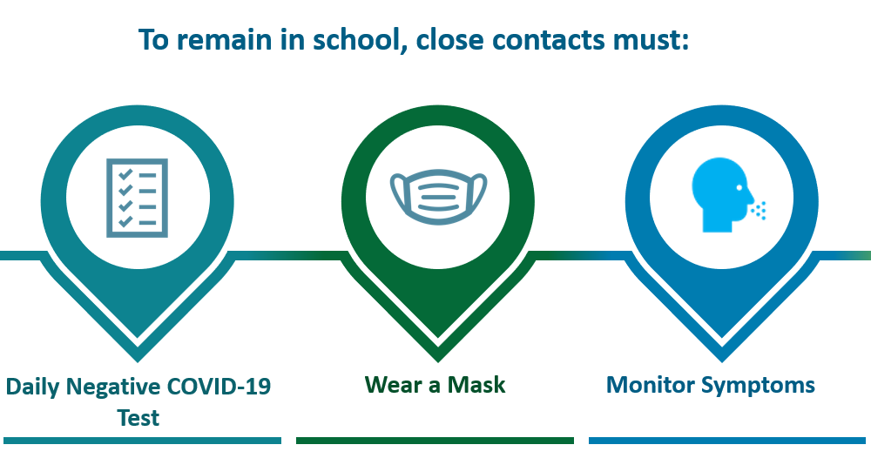
What is Test to Stay (TTS)?
A practice of contact tracing and serial testing that allows school-associated close contacts who are not fully vaccinated to continue in-person learning
An alternative to traditional at-home quarantine to minimize the impact of quarantine and school absences
Notes:
Test to Stay (TTS) is a practice of contact tracing and serial testing (testing that is sequentially repeated) to allow school-associated close contacts who are not fully vaccinated to continue in-person learning during their quarantine period.
Test to Stay (TTS) can be implemented by schools as an alternative to traditional quarantine at home by establishing testing protocols to perform at least two tests during the period between close contact notification/TTS enrollment and day 7 after exposure, with the last test occurring 5-7 days after last close contact with a person confirmed with COVID-19. For more information about TTS, visit What You Should Know About COVID-19 Testing in Schools.
Contact tracing and testing as well as masking of contacts during their in-school quarantine period are integral to minimize risk of transmission.
Test to Stay (TTS) can be implemented by schools as an alternative to traditional quarantine at home by establishing testing protocols to perform at least two tests during the period between close contact notification/TTS enrollment and day 7 after exposure, with the last test occurring 5-7 days after last close contact with a person confirmed with COVID-19. For more information about TTS, visit What You Should Know About COVID-19 Testing in Schools.

Slide 15
Centers for Disease Control (CDC)
The CDC has endorsed the TTS strategy
Initial studies found low in-school COVID-19 transmission with TTS
Notes:
CDC advises that schools consider TTS to minimize the impact of quarantine and school absences after a SARS-CoV-2 exposure in the K-12 school setting
Check attack rate 1.5

Slide 16
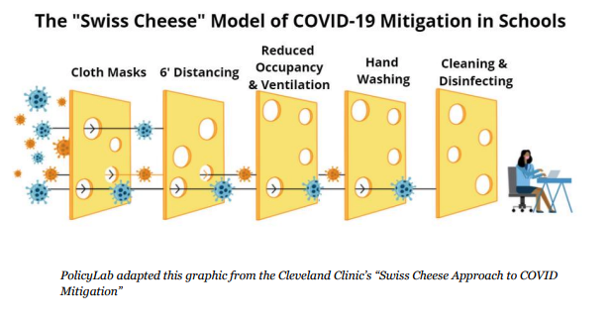
TTS is a valuable tool in a layered prevention strategy
Well-fitting Masks
Distancing
Screening
Testing
Vaccination
Staying Home when Sick
Notes:
TO reduce the risk of transmission
Test-to-Stay is another valuable tool in a layered prevention strategy that includes promoting vaccination of eligible students and staff, requiring everyone age 2 and older wear a mask inside schools and facilities, keeping at least 3 feet of distance between students, screening testing, ventilation, handwashing, and staying home when sick.

Slide 17
TTS is a resource-intensive strategy
Participating schools must have:
Universal masking requirement in place (encouraged)
Adequate resources to conduct contact tracing, testing, and monitoring, including
Designated school point of contact for parents and the local health department
Ability to inform school community of the program, distribute and store consent forms, and distribute test kits & supplies
Ability to monitor participants’ daily symptoms, mask use, and COVID test results, and communicate with families when a student is released from TTS, or is no longer able to participate
Adequate resources to track and report data to VDH (e.g., test kits, enrollment)
Understanding of potential for increased risk of transmission
Appropriate paperwork on file for utilizing BinaxNOW test kits
Notes:
Through the TTS Pilot, VDH will
Resource participating schools with test kits, protocols, and associated guidance;
Assess feasibility of TTS implementation in Virginia schools

Slide 18
TTS Protocol: Who is a close contact?
Close contact is defined as:
Being within 6 ft of a person with COVID-19 for a total of 15 min or more over a 24- hour period; or
Direct exposure to respiratory secretions; or
Caring for or living with a person who has COVID-19; or
Exception: In indoor and outdoor K-12 settings, a student who was within 3 to 6 feet of an infected student is not considered a close contact as long as both students wore well-fitting masks the entire time.
Applies to school buses when there are documented seating charts and assurance that masks are worn and students remain in assigned seats
Notes:
First step for Test to Stay is determining who a close contact is in the school setting after a person is identified as COVID positive. The K-12 exception does not apply to teachers, staff, or other adults. This means that the standard close contact definition is applied when assessing exposure in a K-12 setting that involves a student with an infected adult or an exposed adult. VDH will continue to monitor the science regarding the effectiveness of this close contact definition and the associated K-12 exception, and will update guidance as necessary. For more details about close contact and quarantine in K-12 school settings, see Clarification of VDH K-12 Close Contact Definitions and Quarantine Periods.

Slide 19
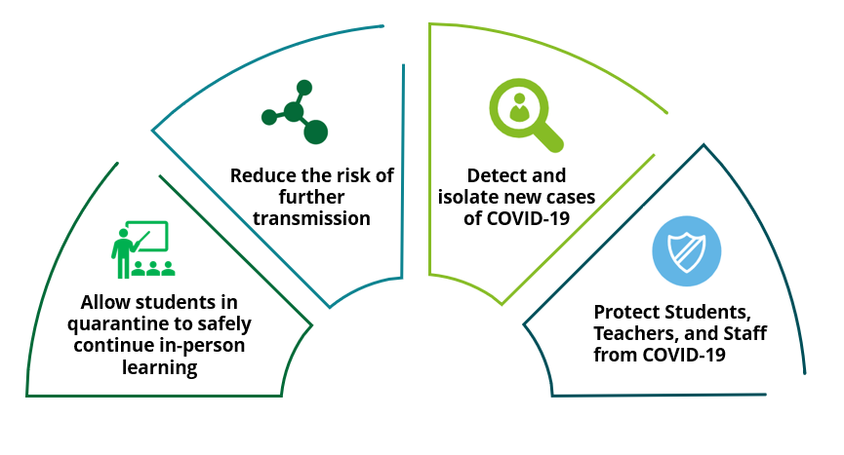
Goal of TTS in K-12 Schools
When schools implement TTS combined with other mitigation strategies, they can:
And limit the impact of school absences on students & the entire school community

Slide 20
Thank you!
laurie.forlano@vdh.virginia.gov

Slide 21
Extra Slides

Slide 22
CDC Guidance Update - Shortened I/Q Period
Guidance is for the general public and does not apply to:
Healthcare workers (CDC Healthcare Worker Guidance issued 12/23/21 stands)
Healthcare patients/residents
Visitors to healthcare settings:
Cases should stay away from nursing homes and other high-risk settings until at least 10 days after symptom onset (or date of positive test, if asymptomatic).
Those under quarantine should avoid nursing homes for at least 10 days after exposure.
Those severely ill with COVID-19 or with a weakened immune system; these individuals must isolate for at least 10 and up to 20 days (consult HCP)
Higher-risk congregate settings, such as:
Correctional and detention facilities
Homeless shelters
Cruise ships
Childcare facilities - Recommend not applying shortened I/Q guidance as a best practice; Shortened I/Q may considered for childcare staff if there are critical shortages.
Guidance does apply to community settings, K-12 settings and IHEs
COVID-19 Quarantine and Isolation | CDC

