Slide 1
CHRONIC ABSENTEEISM TASK FORCE UPDATE
Monday, January 8th

Slide 2
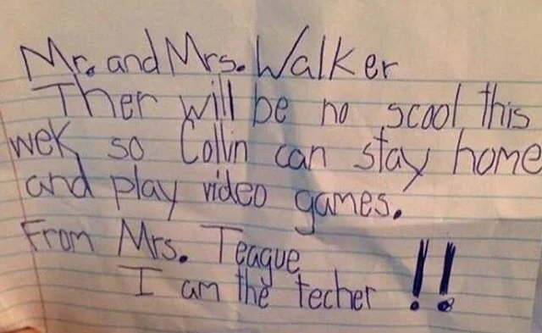

Slide 3
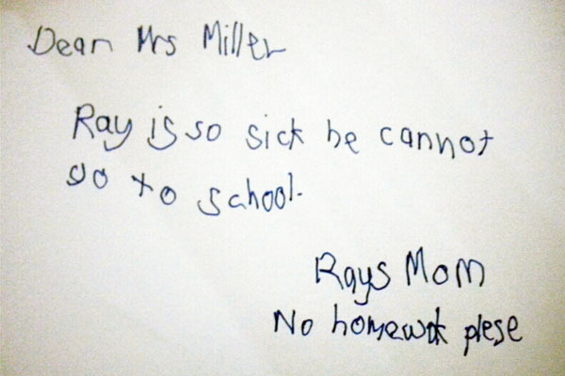

Slide 4
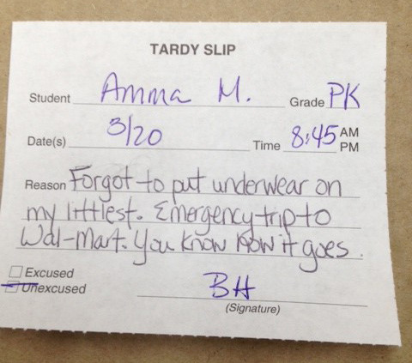

Slide 5
 | 2018-2019 | 2021-2022 (w/ waivers) | 2021-2022 (w/o waivers) | 2022-2023
LOUISA COUNTY PUBLIC SCHOOLS | 7.8% | 10.5% | 33.7% | 8.0%

Slide 6
OUR MOTIVATION
When students are not in school, their academics will suffer.
Good attendance prepares students for the workforce and the expectations that come along with being part of an organization, community, and team.
Poor student attendance places a tremendous amount of stress on teachers.

Slide 7
TOPICS OF DISCUSSION
Mental Health & Medical
Family Engagement
Food Insecurity
Transportation
Educational Neglect Legislation
Meaningful Engagement

Slide 8
MENTAL HEALTH
& MEDICAL

Slide 17
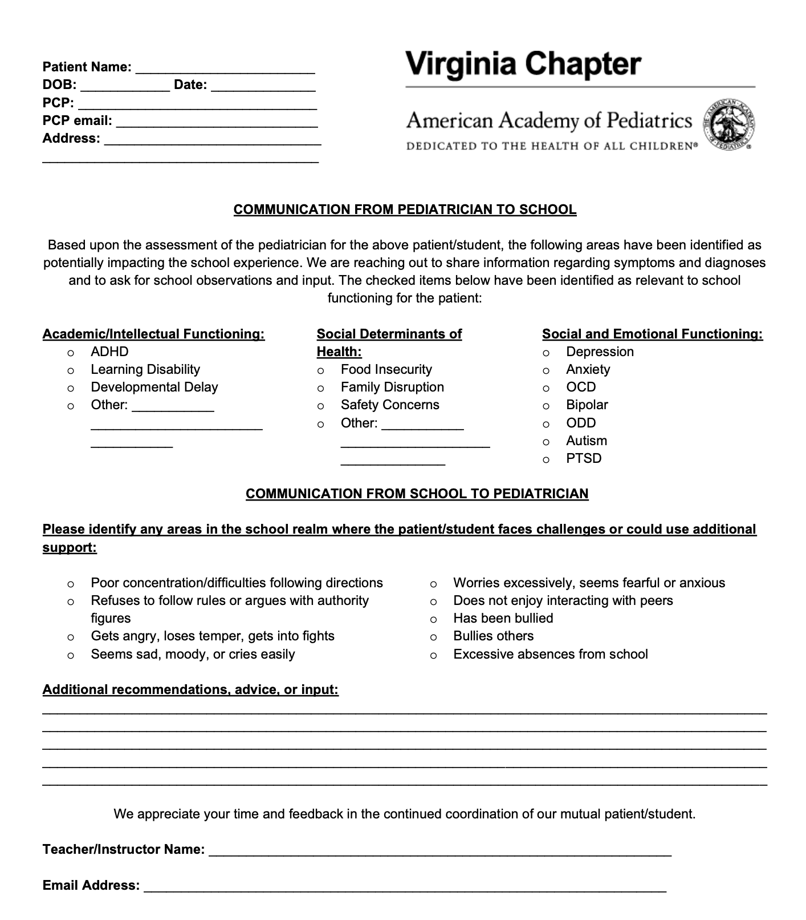
COMMUNICATION FROM PCP TO EDUCATIONAL SYSTEM

Slide 18
FAMILY ENGAGEMENT

Slide 19
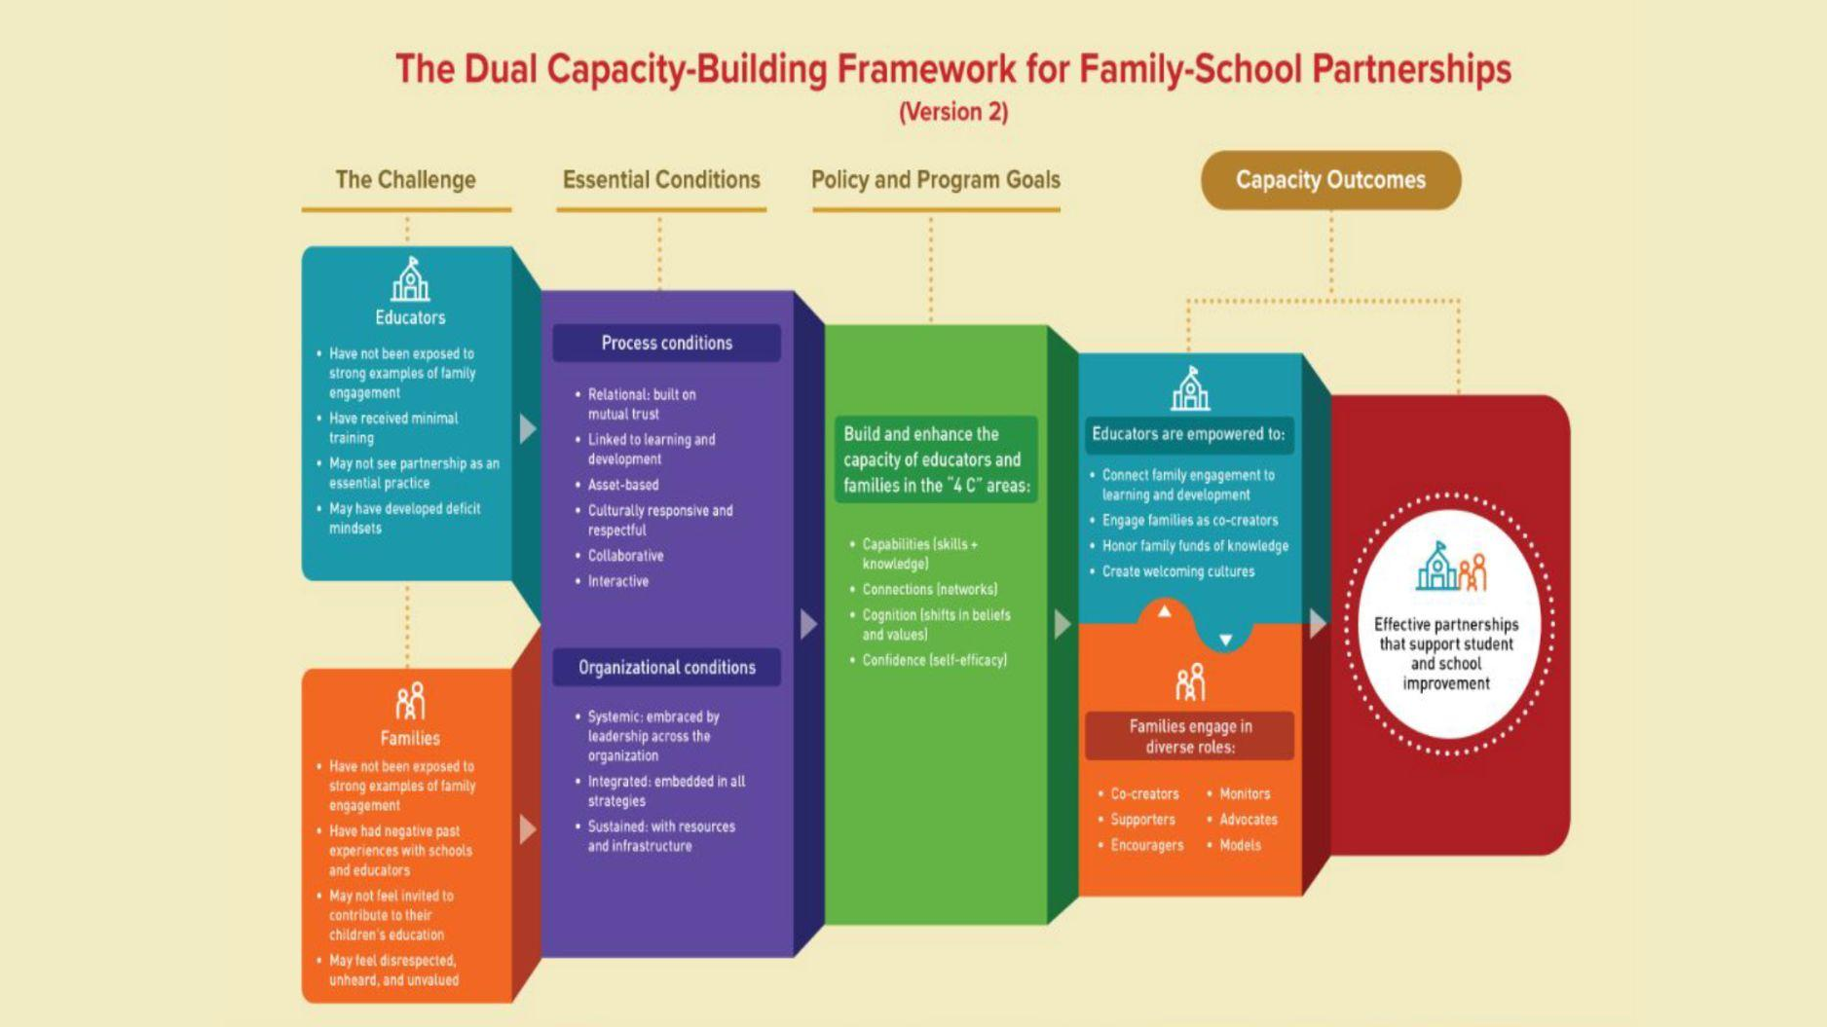

Slide 24
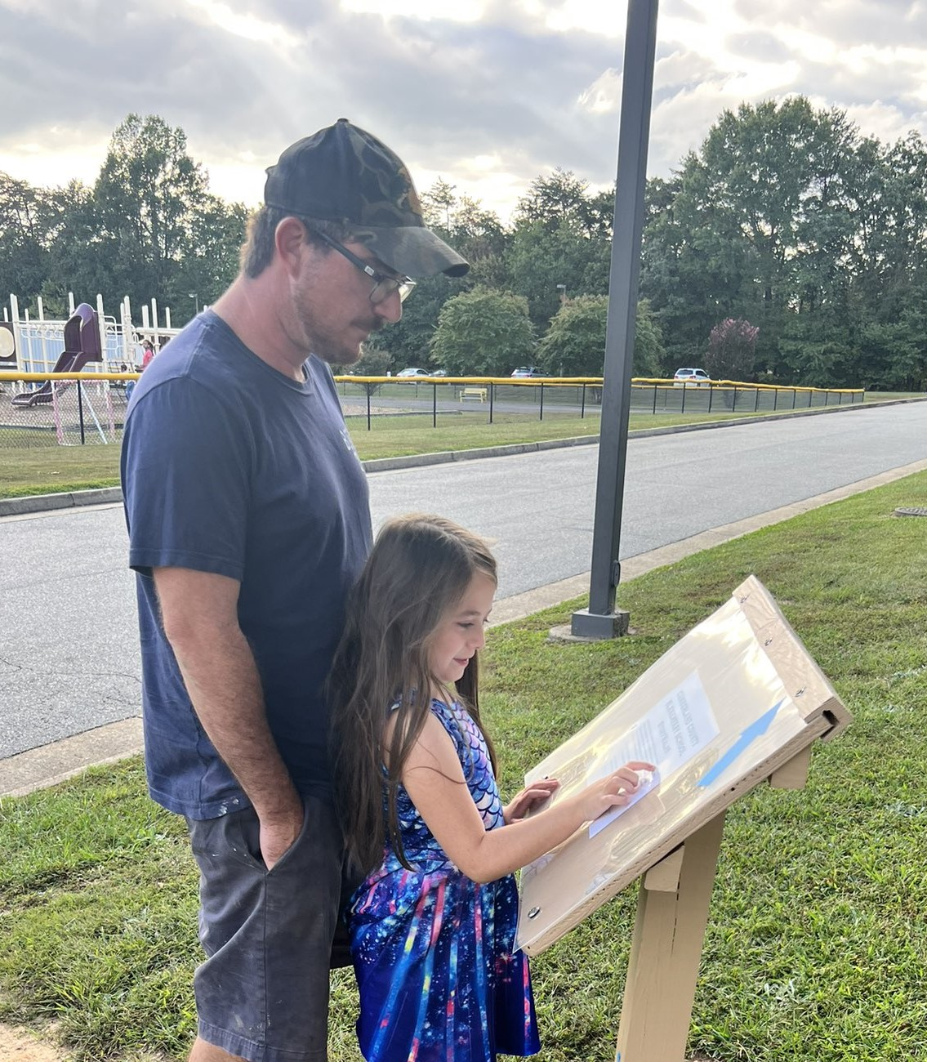
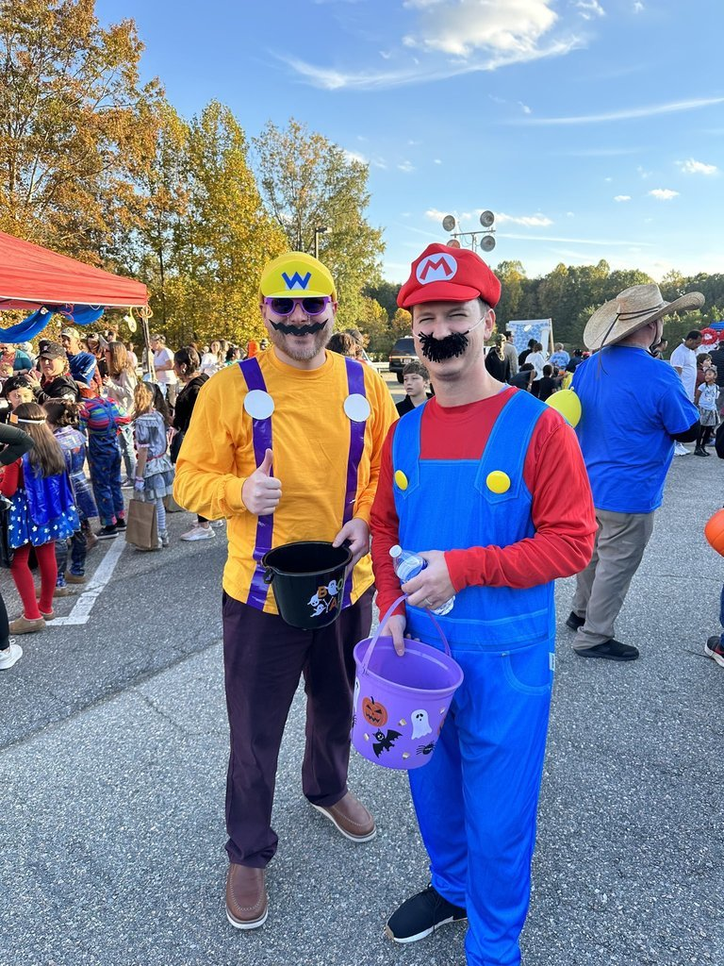

Slide 25
FOOD INSECURITY

Slide 31
TRANSPORTATION

Slide 32
TRANSPORTATION
UNDERSTANDING MODES | TRACKING RIDERSHIP/UTILIZATION
DIFFERENTIATION SERVICES

Slide 33
3 PRACTICES
TO CONSIDER
Understand the various modes of transportation (School bus/van, walking, biking, dropped off by parents, carpooling)

Slide 34
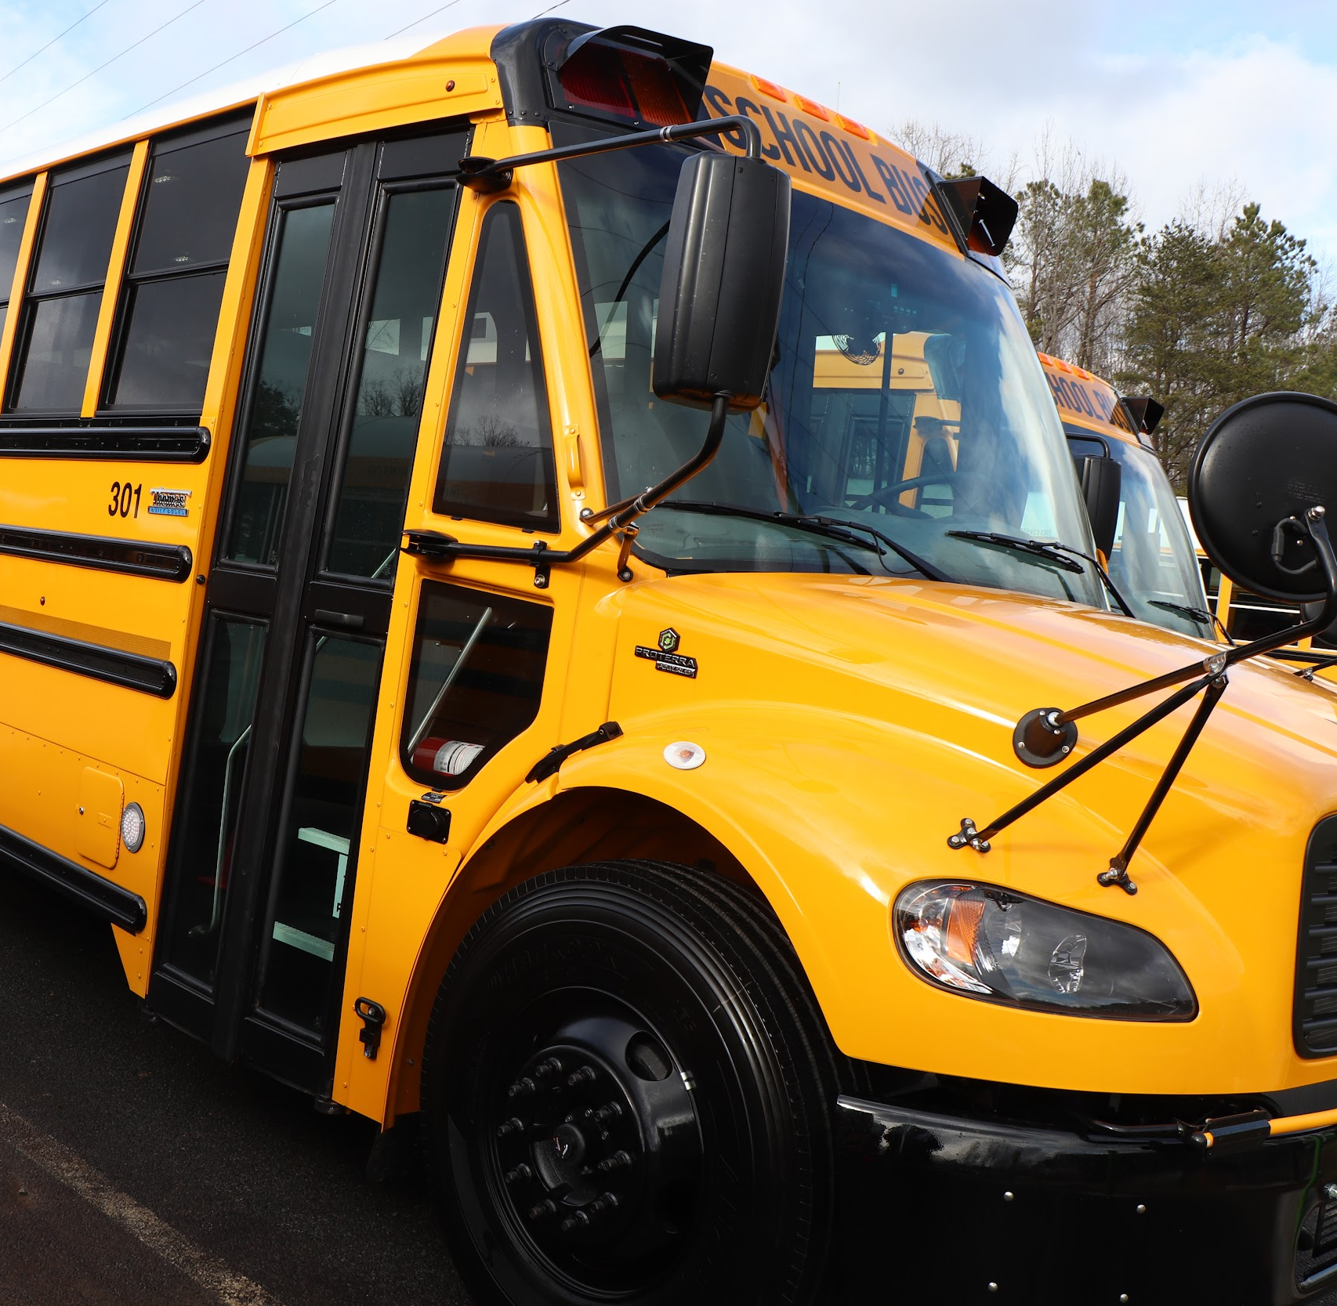
3 PRACTICES
TO CONSIDER
Track actual ridership/utilization (Are the actual uses meeting the needs?)

Slide 35
3 PRACTICES
TO CONSIDER
Strategically differentiate service (Is transportation a problem?)

Slide 37
3 PRACTICES
TO CONSIDER
Understand the various modes of transportation (School bus/van, walking, biking, dropped off by parents)
Track actual ridership/utilization (Are the actual uses meeting the needs?)
Strategically differentiate service (Is transportation a problem?)

Slide 38
EDUCATIONAL NEGLECT LEGISLATION

Slide 39
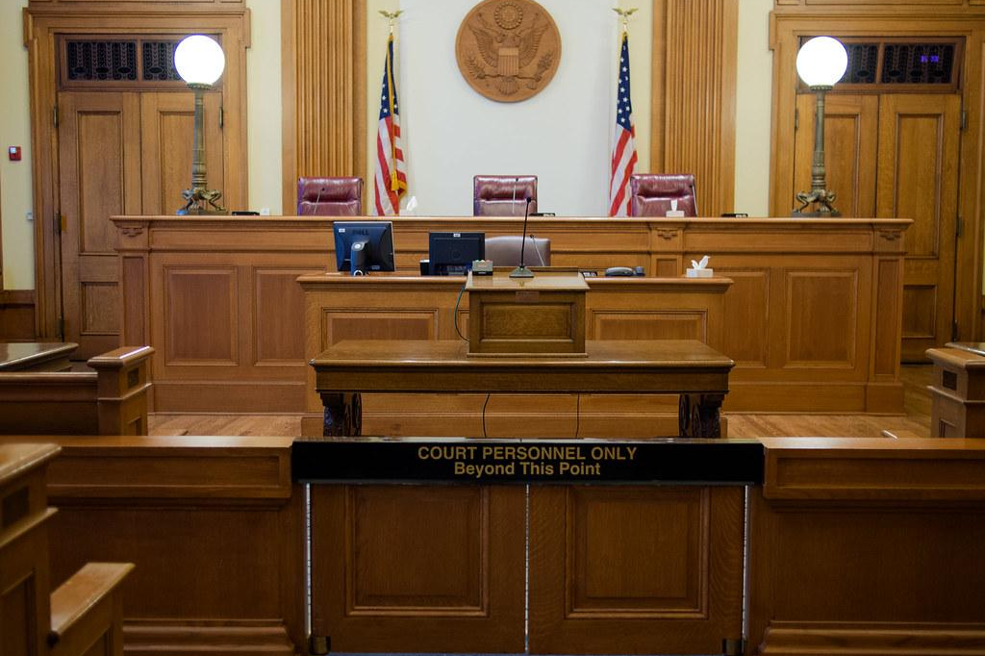
CURRENT PRACTICE
Virginia defines abuse and neglect a little differently than most states.
Whereas most states clump different types of neglect into one basket, like this example from South Dakota "Whose parent, guardian, or custodian fails or refuses to provide proper or necessary subsistence, supervision, education, medical care, or any other care necessary for the child’s health, guidance, or well-being;"
Virginia separates abuse in neglect into separate categories; physical, mental, and sexual (see 22VAC40-705-30. Types of abuse and neglect.)

Slide 40
SUGGESTED LEGISLATION
Add a section to 22VAC40-705-30 that would cover educational neglect.
Educational neglect occurs when the child's caretaker permits chronic truancy (defined as 10% of the school year - 18 days per year or 9 days per semester), fails to homeschool, register, or enroll a child of mandatory school age, or fails to allow or obtain recommended remedial educational services or services provided by the child's IEP, without reasonable cause.

Slide 41
MEANINGFUL
ENGAGEMENT

Slide 42
WE HAD TO CHANGE A
MINDSET

Slide 43
OUR STRATEGIES
Utilized a team approach to the issue.
Hired Attendance Specialists for each school.
Defined roles and responsibilities for all team members.

Slide 44
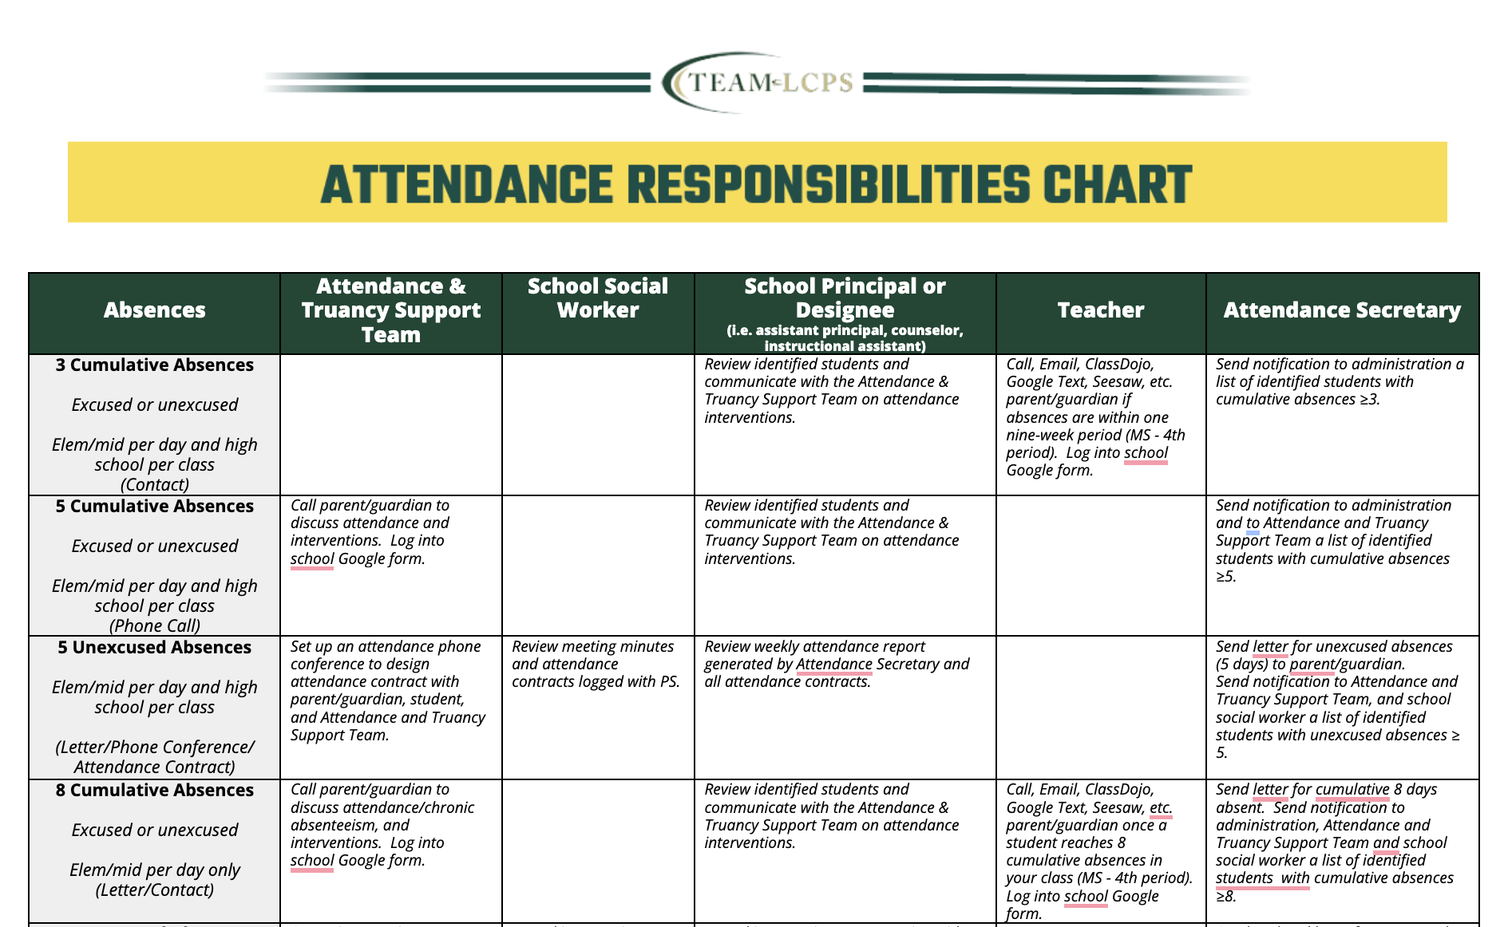

Slide 45
OUR STRATEGIES
Utilized a team approach to the issue.
Hired Attendance Specialists for each school.
Defined roles and responsibilities for all team members.
Provided immediate feedback & communication with families (beyond a robocall).
Find out barriers students/families are facing during these personal connections.
Immediate make-up of instruction with meaningful engagement after 5 missed days of school. (Excused and Unexcused)

Slide 46
HELPING STUDENTS MAKE UP FOR
MISSED INSTRUCTIONAL TIME
Must be meaningful engagement
May mean a student’s school day ends at 6 p.m. instead of 3:30 p.m.
Excused or unexcused
After-school instruction (meals and transportation provided)
Additional counseling services, if needed

Slide 47
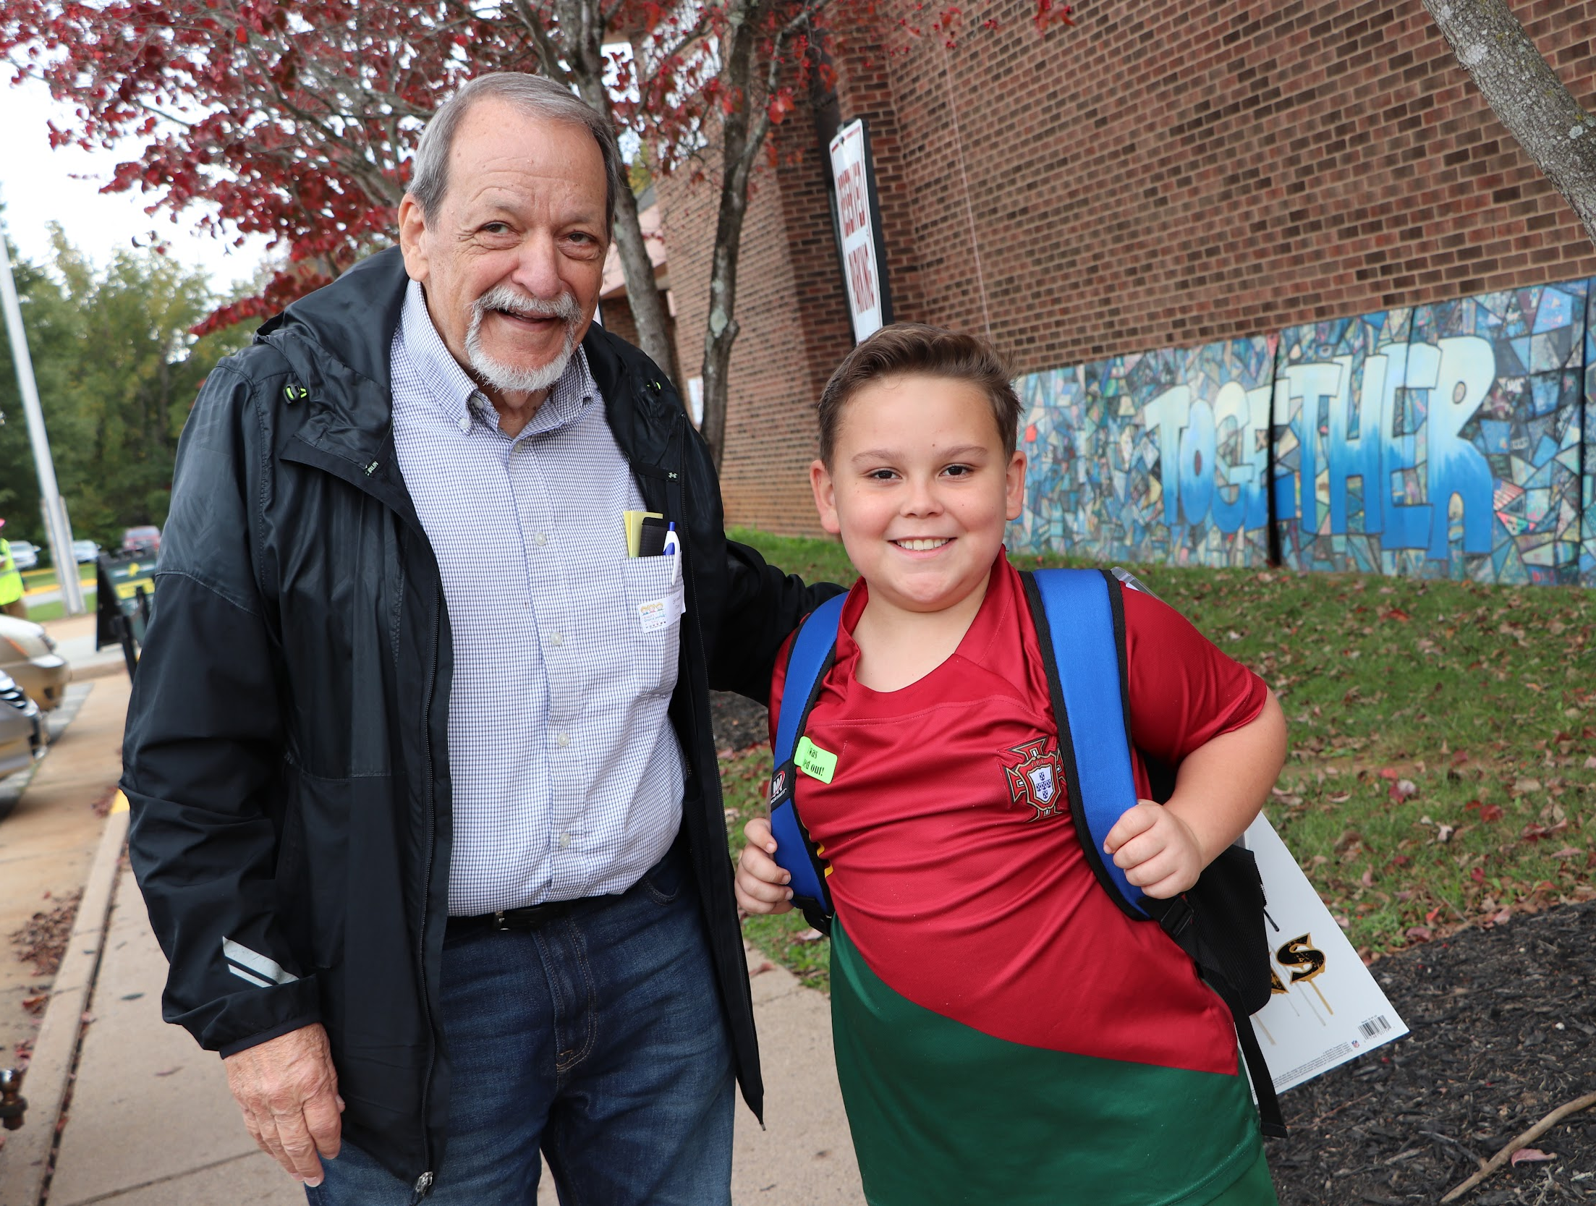
IT’S ALL ABOUT HELPING YOUR COMMUNITY EMBRACE
YOUR VISION!

