Slide 1

Virginia’s Budget
Considerations During the 2021 Session
VASS-VASBO
Winter Conference
Fiscal Analytics, LTD
James J. Regimbal Jr.
January 11, 2021
1

Slide 2
The Economic and Revenue Forecast Has Improved Since the Special Session Forecast
Despite a nasty economic reversal from last year, the U.S. and Virginia are recovering. Economic indicators have markedly improved since the 1st Q bottom. VA initial unemployment claims continued to decline from 50,000 in May to 11,890 the week of Dec. 26. VA continuing unemployment claims have dropped from 400,000 in May to 63,443 for the week of Dec. 26 (vs. 19,097 one year ago).
However, Virginia payroll employment in November was still 6% below last year – about half the lowest level in the spring – and a labor force participation rate of 63.7% - the lowest since this data was tracked in 1976. VA unemployment was 4.6% in November versus 2.5% last year (6.4% in U.S.).
GF revenues are holding up better than most states due to Virginia’s stable economic mix of industries and tax profile. Expectations for personal income and wages and salary growth have improved since the Special Session forecast. The August 2020-22 GF forecast reduction of $2,806.5 million was upgraded by $1,257.4 million in December. Expect the sales tax forecast in particular to be upgraded again.
The August state transportation revenue 2020-22 forecast reduction of $750 million was upgraded by $170 mil. in December due to better retail sales, auto sales, and motor fuel taxes than previously assumed.

Slide 3
There Is Reason for Hope in 2021
Yes, small businesses are still closing across the country, the virus is again surging, more than 10 million Americans are either jobless or working fewer hours than before and a wide disparity exists between the home-owning majority and millions struggling to survive and who continue to need a bridge to when we can post-vaccine fully reopen our economy.
But…most American consumers are generally doing better than expected thanks to stimulus payments, enhanced unemployment benefits, forgivable loans to small business, lower interest rates, and forebearance programs. Average personal incomes are significantly higher than before the pandemic due in part to a restructuring of the workplace for high-skill employees (i.e., working from home).
However, normal consumer spending – particularly on services - has been depressed by the virus resulting in about $1.5 trillion in extra savings since February - or 10% of normal spending, and savings rates are currently 12%.
Alternatively, the 25% increase in money supply has caused asset prices to surge and consumers have improved balance sheets - having paid down $150 billion in revolving debt, added $2 trillion in bank and money market deposits and accumulated $300 billion in lasting durable goods. Home equity has increased by $1 trillion and stock market holdings have surged in value. Total U.S. household net worth is up $5 trillion.
The overall business sector is also in solid shape with the nonfinancial corporate ratio of liquid assets to debt at its highest level since 1955. Even noncorporate businesses overall financial position has stayed about the same in the face of the tremendous Covid challenges.
The 500,000 new business applications with the IRS this year are 6% above recent averages – portending solid new business creation.

Slide 4
Hopefully “Creative Destruction” Will Occur
The longer the pandemic continues, the more entrenched teleworking/home-based businesses becomes, and the less entrenched commuting and business travel becomes. This will have long-term impacts on public transportation, airlines and commercial real estate, particularly retail and office space. Residential housing prices may continue to surge.
Virtual education is obviously accelerating rapidly, but with consequences. Working parents (esp. females) are impacted, due to greater childcare responsibilities. One potential future - some parents may continue to use alternative methods of teaching children after the pandemic is over. The Virginia Department of Education currently does not forecast a rebound in public school student counts in FY 2022.
On a more positive note, more innovation and entrepreneurship occurs during recessions when problems are highest. Government data shows, “Americans are starting new businesses at the fastest rate in more than a decade” (Sept. WSJ). Also, the pandemic has propelled collaboration in service of society. Companies with extensive libraries of drugs are rapidly innovating, scientists who haven’t historically worked together are collaborating on research efforts, and thought leaders are sharing ideas across fields.
Notes:
This is complicated but fits with your second bullet and probably should be mentioned: In October, Virginia’s labor force participation rate fell to 63.5%, its lowest level since at least 1976, the first year the Bureau of Labor Statistics published state-level data.
Since the start of the COVID-19 pandemic in March, over 175,000 Virginians have left the labor force, around 3% of the state’s work-eligible population. But, while the pandemic certainly accelerated the process, it’s a continuation of a trend the state, and the whole country, has been experiencing throughout the 21st century.

Slide 5
GF Revenue Forecast Significantly Improved From Special Session

Slide 6
Will GF Revenues Continue Stronger Growth?
Expect the Sales Tax Forecast to be Upgraded Significantly
Source: Secretary of Finance presentation to Money Committees, Dec. 16, 2020

Slide 7
Almost All Virginia Income Tax Liability
Is From Taxpayers Over $50,000 in Income
7
 | % of Tax Returns | % of Total Tax Liability
Under $25,000 | 30.5% | 1.4%
$25,000-50,000 | 21.5% | 7.2%
$50,000-150,000 | 35.2% | 36.8%
$150,000-500,000 | 11.7% | 36.7%
Over $500,000 | 1.0% | 17.9%
Totals | 100.0% | 100.0%
Source: Dept. of Taxation/Chainbridge Software analysis of TCJA impact

Slide 8
On-Line Sales Have Soared Along With
Sales Tax Credited to Place of Residence
Source: Dept. of Taxation

Slide 9
GF Appropriations Growth From FY 2014-20
 | FY 2014 | FY 2020 | $ Change | % Change
Legislative and Executive | $103.2 | $134.3 | $31.1 | 30.1%
Judicial Dept. | $425.2 | $507.3 | $82.1 | 19.3%
Administration/Comp Board | $654.1 | $740.0 | $85.9 | 13.1%
Treasury Board Debt Service | $608.5 | $776.4 | $167.9 | 27.6%
Other Finance | $171.8 | $182.0 | $10.2 | 5.9%
Rainy Day Fund Deposit | $339.6 | $360.5 | $20.9 | 6.2%
Car Tax Reimbursement | $950.0 | $950.0 | $0.0 | 0.0%
Commerce and Trade | $183.3 | $302.3 | $119.0 | 64.9%
Agriculture / Nat. Resources | $144.0 | $256.4 | $112.4 | 78.1%
K-12 Education/DOE | $5,292.7 | $6,581.4 | $1,288.8 | 24.3%
Higher & Other Education | $1,782.1 | $2,274.0 | $491.9 | 27.6%
DMAS Medicaid | $3,519.8 | $4,988.7 | $1,468.9 | 41.7%
Other Health & Human Services | $1,541.5 | $2,085.2 | $543.7 | 35.3%
Public Safety & Veterans/HS | $1,699.0 | $2,072.3 | $373.3 | 22.0%
Transportation | $42.0 | $41.0 | -$1.0 | -2.4%
Central Appropriations | $247.2 | $273.5 | $26.3 | 10.6%
Cash Reserve | $0.0 | $222.8 | $222.8 | NM
Independent Agencies/Capital | $1.2 | $3.2 | $2.0 | 166.7%
Total GF Appropriations | $17,705.2 | $22,751.3 | $5,046.1 | 28.5%
9
9

Slide 10
Key Budget Changes from the Special Session
Additional GF biennial savings of about $280 million, primarily from reductions in Medicaid, FAMIS, and Children’s Health Insurance and state matching rates, state health insurance premium holiday and reduced rates, and increased ABC profits.
Increased GF spending of about $470 million, including numerous health, human and mental health service initiatives, criminal justice reform related spending including $7 mil. for local police departments and a $500 bonus for other law enforcement personnel, fully restored the K12 at-risk add-on increase and partially restored Virginia Preschool Initiative funding in the second year.
Left an unappropriated balance of $302.2 mil., which relied on previous year carryforwards and had a structural imbalance in spending above FY 2022 revenues.
Authorized $97.8 mil from the GF for a bonus for state employees and state-supported local employees contingent on available final FY 2021 revenues. Also directed the Governor to include a salary increase in his December introduced budget for K-12 instructional and support positions during the second year if sufficient revenue is projected.
Provided $95.2 million the first year from the COVID-19 Relief Fund (gray machine revenue), distributed to school divisions based on the net reduction of state funds in the introduced budget, and counted as local match payments for the SOQ.
Left $1.1 billion in reserves.
10
10

Slide 12
New K-12 GF Spending in the Introduced Budget
No loss funding to offset projected ADM losses for the biennium. ADM forecast for FY 22 assumes no rebound from pandemic losses.
  On a statewide basis, the revised ADM projections are 44,096 students lower in FY 2021 and 44,296 students lower in FY 2022 than the original projections. Without no loss funding, the ADM updates would have resulted in an estimated decrease in Direct Aid payments on a statewide basis of $201.2 million in FY 2021 and $202.9 million in FY 2022
$80 mil. for a 2 percent bonus for SOQ instructional and support positions
$61.3 mil. VRS teacher retirement plan deposit to help address unfunded liabilities.
$27 mil. for school counselors pursuant to the Standards of Quality. This action reduces the staffing ratios to 325-to-1 in all schools in FY 2022.
$11.1 for additional 10% boost in VPI per pupil funding to $7,655, plus $5 mil. to restore unallotted Early Childhood Initiative funding.
ESL program testing suspended, resulting in presumptive ESL funding that restores $4.3 mil. of $11.8 mil. reduction in FY 2021 and $6.5 mil. of $19 mil. reduction in FY 2022.
$95 mil. “Grey Machine” revenue returned to Governor’s “Covid 19 Relief Fund”. Additional sales tax and $52.9 mil. GF to replace “Grey Machine funding.

Slide 13
Other New GF Spending in the Introduced Budget
(Left a $1.9 B Reserve and $51 M Unappropriated Balance)
13
$650 million deposit to cash reserve fund in FY 22.
$98 mil. for state and state-supported local employee bonus
$89 mil. for mass vaccination efforts
$79 mil. for Emergency Management COVID-19 disaster response funding
$50 mil. to expand Amtrak service to Christiansburg
$41 mil. for increased funding for the Virginia Housing Trust Fund
$39 mil. for state employee health insurance plan deposits to help address unfunded liabilities
$36 mil. for VCCS funding to implement the “Get Skilled, Get a Job, Give Back Program”
$30 mil. to restore undergraduate student financial assistance
$25 mil. for criminal record expungement including marijuana and related legislation
$15 mil. in additional funding for broadband deployment
Notes:
Might want to mention that the Special Session provided +$7.0 million for local police departments for recruitment and retention of officers. Nothing in the introduced budget.

Slide 14
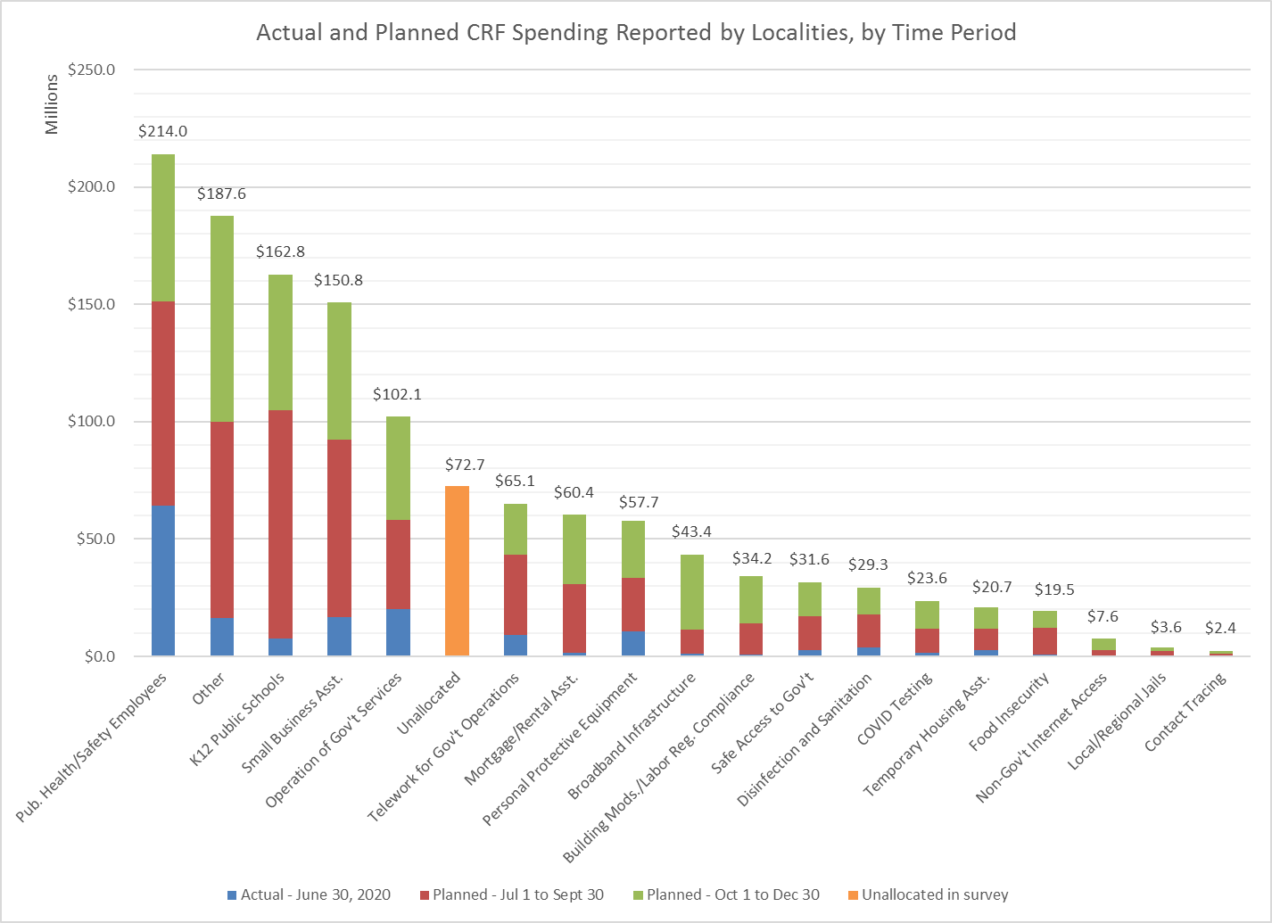
DPB Survey of $1.3 Billion Local Cares Act Spending
14
14

Slide 15
New CRRSA Act
Helps VA Schools With $1 Billion in Additional Aid
15

Slide 16
CRRSA - K12 Allowable Uses
Providing principals and others school leaders with the resources necessary to address the needs of their individual schools.
Activities to address the unique needs of low-income children or students, children with disabilities, English learners, racial and ethnic minorities, students experiencing homelessness, and foster care youth.
Developing and implementing procedures and systems to improve the preparedness and response efforts of local educational agencies.
Training and professional development for staff of the local educational agency on sanitation and minimizing the spread of infectious diseases.
Purchasing supplies to sanitize and clean the facilities of a local educational agency, including buildings operated by such agency.
Planning for, coordinating, and implementing activities during long-term closures, including providing meals to eligible students, providing technology for online learning to all students.
Purchasing educational technology (including hardware, software, and connectivity) for students who are served by the local educational agency that aids in regular and substantive educational interaction between students and their classroom instructors, including low-income students and children with disabilities, which may include assistive technology or adaptive equipment
Providing mental health services and supports.
Planning and implementing activities related to summer learning and supplemental after school programs, including providing classroom instruction or online learning during the summer months.
Addressing learning loss among students, including low-income students, children with disabilities, English learners…
School facility repairs and improvements to enable operation of schools to reduce risk of virus transmission and exposure to environmental health hazards, and to support student health needs.
Inspection, testing, maintenance, repair, replacement, and upgrade projects to improve the indoor air quality in school facilities, including mechanical and non-mechanical heating, ventilation, and air conditioning systems, filtering, purification and other air cleaning, fans, control systems, and window and door repair and replacement.

Slide 17
“Wild Cards” Will Continue to Drive Budget Uncertainty
It will be May/June tax filing before the full extent of the impact on state revenues is known. Full economic recovery depends on the end of the pandemic.
  YTD indicates higher sales tax than the introduced budget forecast (XMAS season is the wildcard) – further improving K-12 distributions, transportation, and local budgets.
  Virginia will also need to consider tax de-conformity from Cares Act business tax reductions.
Significant additional federal help for COVID-19 testing/vaccines, PPE, childcare, housing, broadband, rental assistance, and an additional $1 bil. in K-12 funds. Does this offset need for some introduced general funds?
Expect Medicaid budget pressures to resume in the 2022-24 biennium. Six percent growth would require $1.1 bil. GF
FY 2022 introduced budget has ongoing spending $366 mil. more than current estimated ongoing revenues. This could produce continued conservative budgets in the future.
Does state de-conform from federal tax changes in CRRSA that would cost over $600 million? Potential new federal tax changes from new Congress that impact Virginia revenues?
Notes:
Full tax conformity would cost the state treasury over $700 million (business and individual tax breaks) if I remember correctly. Might be worth saying.

Slide 18
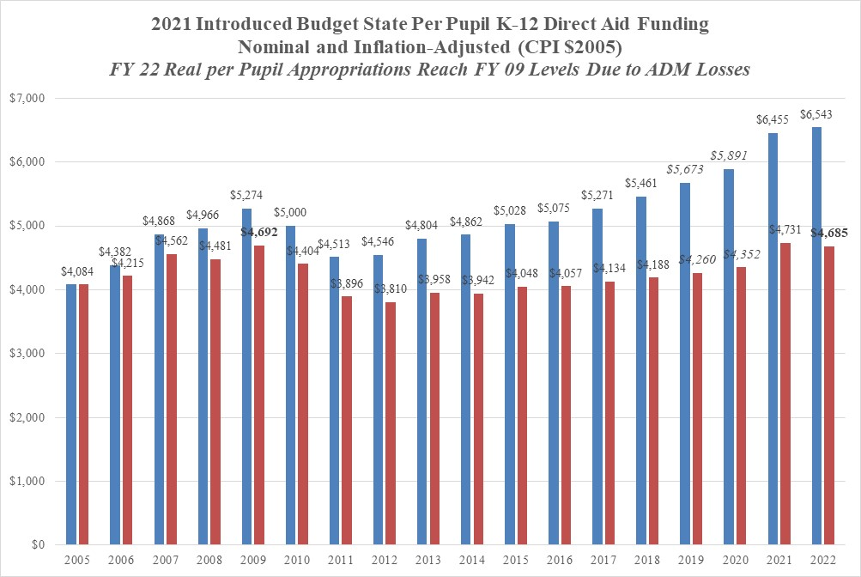
Source: https://www.doe.virginia.gov/school_finance/budget/calc_tools/index.shtml

Slide 19
March 2021 ADM Expected to Decline by 3%
SOQ Is Funded on a Per Pupil Basis
(Hold Harmless Proposed in Introduced Budget)
19
19

Slide 20
Virginia Instructional Pay Increases Have Slowed Considerably Since 2009
Source: Superintendent’s Annual Report.
*All instructional positions include classroom teachers, guidance counselors, librarians, principals, and assistant principals.

Slide 21
State-Funding for Teacher Salary Increases Lags Inflation
(2% Salary Increases in FY 21 and FY 22 Unallotted)
21
Note: Introduced budget includes a 2% bonus for FY 2022
21
Notes:
You might want to mention our favorite teacher salary statistic regarding Virginia’s national ranking and the change occurring when PDC 8 is removed from the calculation

Slide 22
Local K-12 Operations Funding Grew Much Faster Than
State Operations Funding from FY 2009-19
6% growth
21% growth
Source: DOE Superintendents Annual Reports
http://www.doe.virginia.gov/statistics_reports/supts_annual_report/index.shtml
22

Slide 23
What does the Future Hold for Local Budgets Hit
by the Covid Shutdowns?
23
A greater revenue reliance on restaurants, entertainment venues, hotels, and other commercial real estate hit harder by mandated business closures or restrictions. Fortunately, residential real estate values are holding up well – portending stable or rising assessments. Unknown how commercial real estate assessments will change over time.
Sales tax revenue impacts will vary significantly by locality due to changes in consumption patterns – particularly online vs. brick and mortar. Online sales are recorded where the sale was initiated – generally helping rural localities most. Could have a major impact on future local investments in economic and commercial development.
Local governments usually respond to revenue declines by improving operational efficiencies, cutting social services and canceling or postponing capital projects. Austerity measures often involve payroll reductions through hiring freezes, furloughs, and layoffs.
Evidence from the previous recession also suggests that overall education funding will decline sharply due to COVID-19 recession. Based on the experiences of the 2009 recession and its aftermath, the impact of economic downturns on school budgets may be long-lasting. Spending per student in elementary and secondary schools started to decline in 2009 and did not fully recover to pre-recession nominal levels until 2017.

Slide 24
A Look at Local Revenue Reliance
24
24

Slide 25
Localities Took 3-4 Years To Exceed Lost Local Revenue After Last Recession
25
 | Revenue Growth Comparison ($ Mil.)
Fiscal Year | State GF | % Growth | County Local Revenue | % Growth | Cities Local Revenue | % Growth
2009 | $14,315.1 |  | $11,269.9 |  | $5,541.6
2010 | $14,219.5 | -0.7% | $10,962.5 | -2.7% | $5,377.8 | -3.0%
2011 | $15,040.2 | 5.8% | $11,152.6 | 1.7% | $5,393.9 | 0.3%
2012 | $15,846.7 | 5.4% | $11,450.7 | 2.7% | $5,497.0 | 1.9%
2013 | $16,684.6 | 5.3% | $11,846.8 | 3.5% | $5,601.9 | 1.9%
2014 | $16,411.4 | -1.6% | $12,255.5 | 3.4% | $5,781.4 | 3.2%
2015 | $17,735.6 | 8.1% | $12,815.1 | 4.6% | $5,956.6 | 3.0%
2016 | $18,040.1 | 1.7% | $13,273.6 | 3.6% | $6,163.8 | 3.5%
2017 | $18,695.1 | 3.6% | $13,959.8 | 5.2% | $6,373.1 | 3.4%
2018 | $19,880.8 | 6.3% | $14,452.6 | 3.5% | $6,638.7 | 4.2%
2019 | $21,307.5 | 7.2% | $15,266.7 | 5.6% | $6,877.8 | 3.6%
2020 | $21,737.8 | 2.0% | N/A | N/A | N/A | N/A

Slide 26
26
26

Slide 27
Appendix: JLARC Study of Children's Services Act & Private Special Education Day School Costs
CSA spending for private special education day school services has more than doubled since FY10, growing by approximately 14 percent per year from $81 million to $186 million, accounting for 44 percent of all CSA spending in 2019.
Half of the growth in private day school spending is explained by a 50 percent increase in enrollment over the last 10 years because of three factors: more new children placed in private day schools each year, children being placed in private day schools at younger ages, and children spending more time in private day schools.
Tuition rates increased by 25 percent between FY10 and FY19, similar to inflation during that time. However, tuition rates can vary substantially which has led to questions about reasonableness and profits. However, JLARC found private day schools charge tuition rates consistent with the cost of providing low student-to-staff ratios in small environments, and a majority of schools do not earn excessive profits.
JLARC proposes that state law be changed and CSA funds be used for children in public school settings and believes VDOE would be a more logical administrator of private special education day school funding.

Slide 28
Appendix: JLARC Study of Children's Services Act & Private Special Education Day School Costs
CSA mandates state and local CSA programs (with sum-sufficient funds ) serve children in or at risk of being placed in foster care and children with disabilities who require placements in private day schools. JLARC believes serving non-mandated children with less severe emotional and behavioral issues could be an effective and ultimately less costly child risk prevention strategy and reduce geographical disparities in service availability.
JLARC believes private day school performance expectations should be comparable to those for public schools. Stakeholders and parents of private day school students do not have information on the same basic metrics for private day schools that are reported for every public school in the Commonwealth.
JLARC proposed requiring local programs to measure, collect, and report data on timeliness in service provision and target assistance to those programs that struggle the most with it.
JLARC proposes giving OCS more clear authority to intervene when a local CSA program is ineffective and directing OCS to more actively monitor and work with local CSA programs that need technical assistance or are underperforming.

