Slide 1
Laboratory Schools 2024 VASS/VASBO Winter Conference
Mrs. Joan Wodiska
Chair, College Partnership Laboratory Schools Standing Committee Virginia Board of Education
Dr. Pam Moran
Vice Chair, College Partnership Laboratory Schools Standing Committee Virginia Board of Education

Slide 2
COLLEGE PARTNERSHIP LABORATORY STANDING COMMITTEE
Appointed by the State Board of Education
Develops procedure for receiving, reviewing, and ruling on Lab School applications
Advises the State Board of Education
Advises Lab School applicants (site visits or application feedback)
Board of Education Members
Mr. Bill Hansen
Mr. Andy Rotherham
Education and Professional Community Members
Ms. Joan Wodiska
Mr. John Bailey
Ms. Pam Moran

Slide 3
Laboratory school Funding for Virginia
2022 special session of the GA approved $100M total:
Planning Grants (VDOE)
$5M for planning grants
Lab School Applications (SBE/Lab Cmte)
$20M for initial start-up grants, one-time purchases (Lab School Applications)
$75M for per-pupil operating grants
After state start-up funds, self-sufficient and sustainable

Slide 4
Lab Schools in Virginia
At least 11 lab schools in Virginia, including 3 long-standing Lab Schools at Hampton University, Eastern Mennonite University, and Virginia State University.
1980’s several closed due to budget constraints
Pre-K programs: Converted to childcare centers
High schools shifted to IB and CTE schools.
Lost: Teacher preparation programs and education research.
IALS Emphasis*: (1) study/improve teaching; (2) deeper, personalized student learning; and (3) research developed to benefit the broader education community.
Approx 70 lab schools around the world today
A public elementary, middle or high school operated, in close partnership with a higher education institution and public K-12 school division or school, open to all students through a lottery.
Objective: At least one lab school per Superintendent region.

Slide 5
Laboratory School Purpose
Per VA Code 22.1-349.1, a college partnership laboratory school may be established to accomplish the following :
Stimulate the development of innovative programs;
Provide opportunities for innovative instruction and assessment;
Provide teachers with a vehicle for establishing schools with alternative innovative instruction, scheduling, management, or structure;
Encourage the use of performance-based education programs;
Establish high standards for teachers and administrators;
Encourage collaboration between preschool and postsecondary levels; or
Develop models for replication in other public schools.

Slide 6
Laboratory Schools - Requirements
Code of Virginia identifies the 31 essential that shall be provided or described, such as:
Open to all students, through a lottery process
Compliance with applicable state and federal law (e.g. FERPA or IDEA)
Adherence to standards in 8 categories (e.g. governance, finance, education program, management, procurement)

Slide 7
Virginia: K-12 School Innovative Models
Governor’s Schools
Summer Regional
Summer Residential
Academic Year
Virginia’s Definition for Charter Schools
Career and Technical Schools
Dual Enrollment Programs
Lab Schools

Slide 8
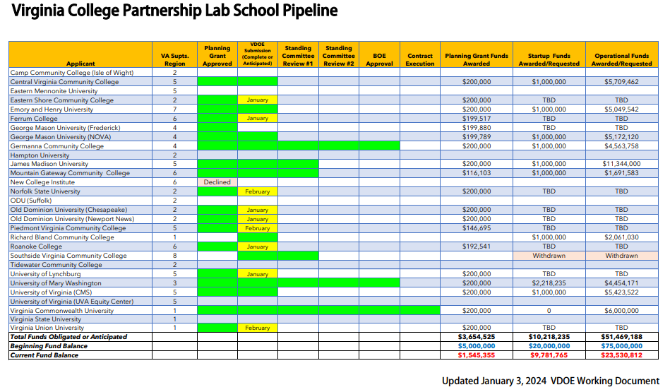

Slide 9
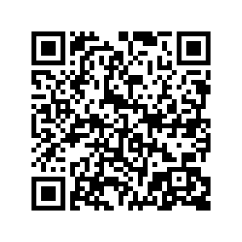
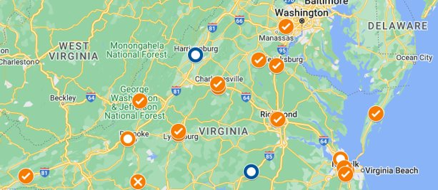
Lab School Planning Grants & Applicant ​Stay Updated

Slide 10
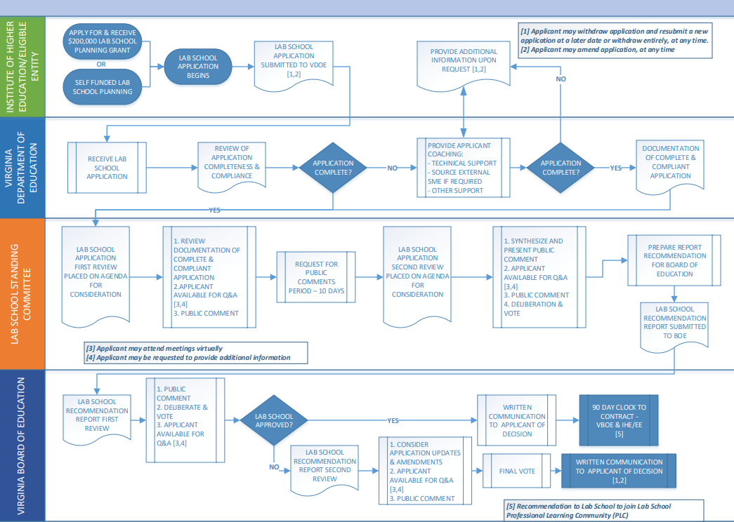
College Partnership Laboratory Committee Application Process

Slide 11
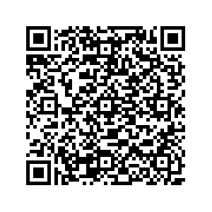
For More Information
VDOE Frequently Asked Questions - Lab Schools
VBOE Standing Committee Webpage

Slide 12
Questions/Resource
Mrs. Joan Wodiska, Standing Committee Chair Joan.Wodiska@doe.virginia.gov

