Slide 1
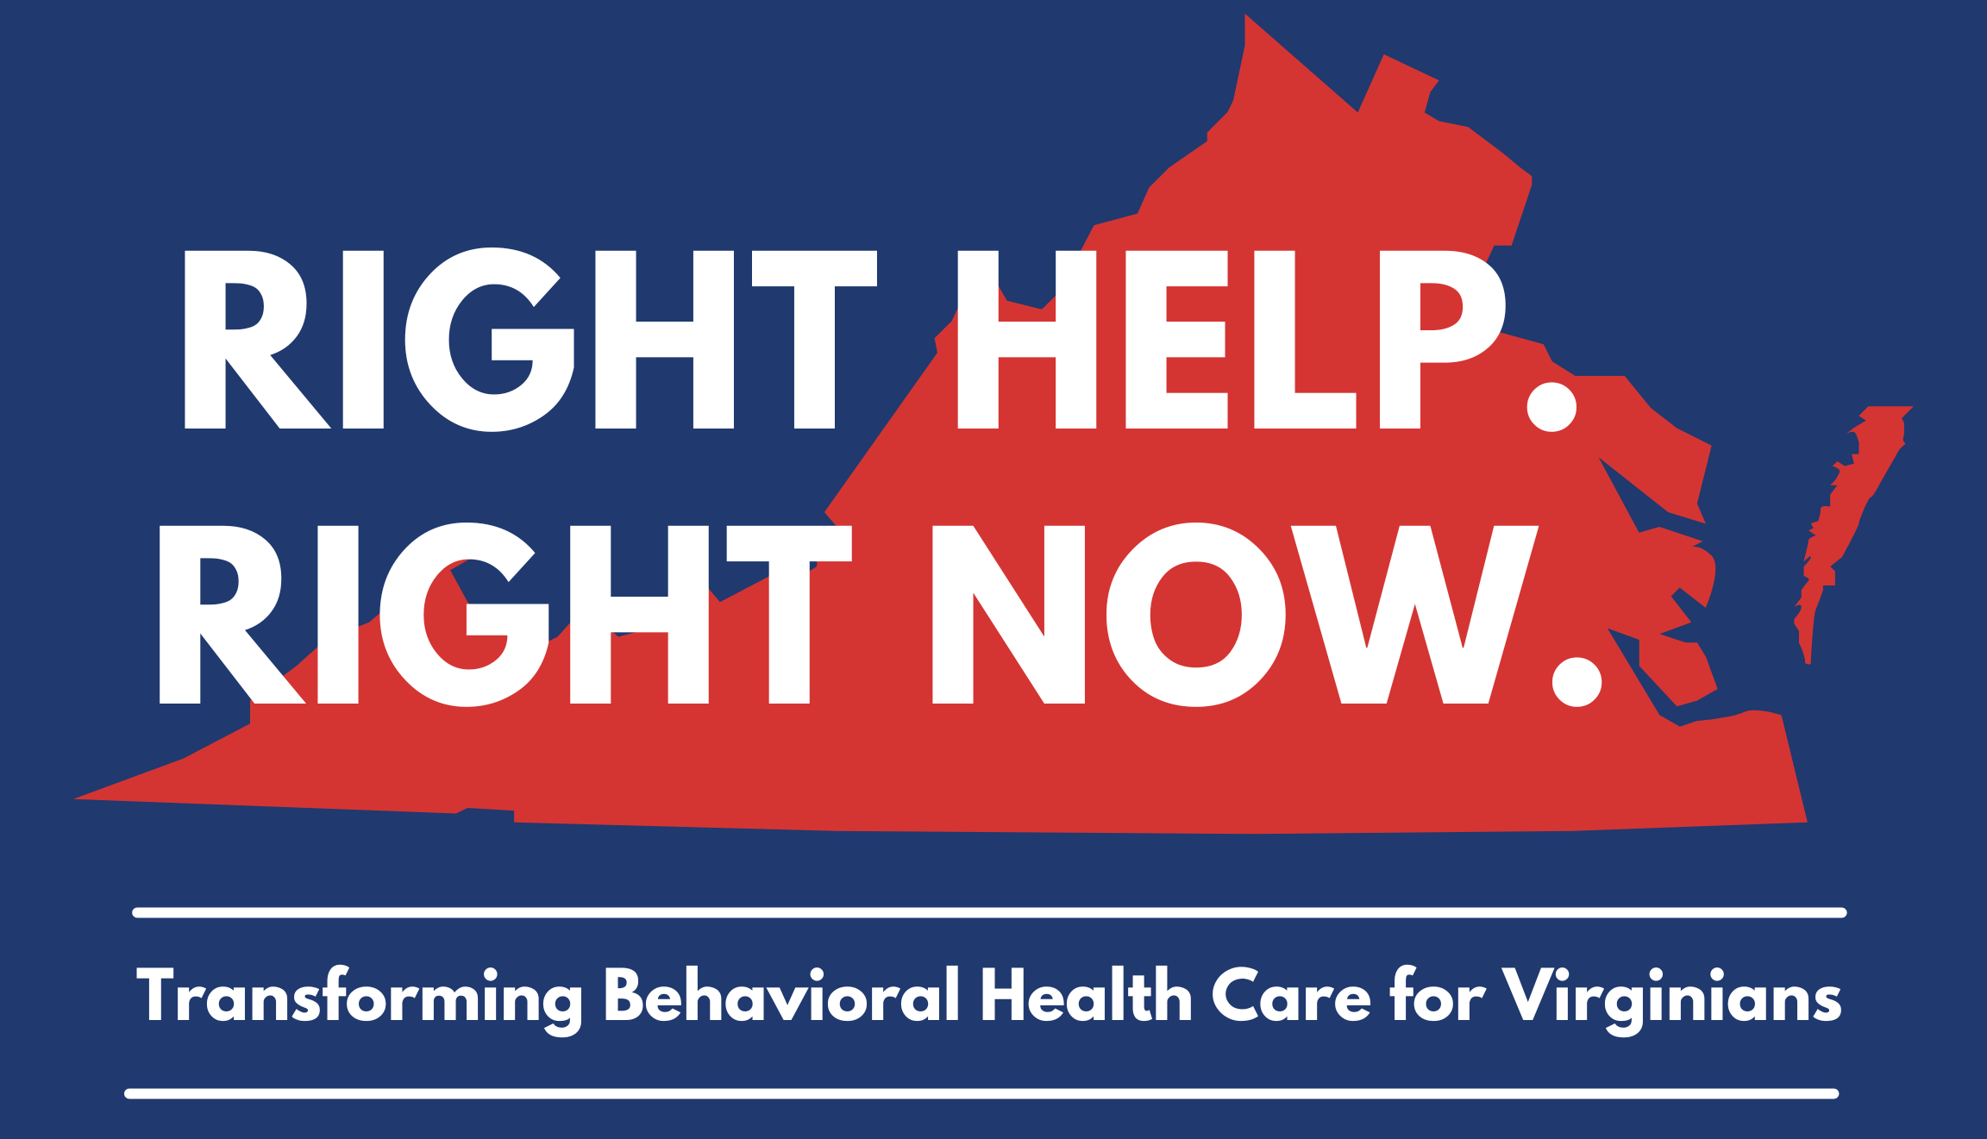
Alexis Aplasca, MD
Senior Clinical Advisor, Behavioral Health Transformation
Office of the Secretary of Health and Human Resources

Slide 2
2025 Vision for Behavioral Health in the Commonwealth
All Virginians will…
… be able to access behavioral health care when they need it,
... have prevention and management services personalized to their needs, particularly for children and youth,
… know who to call, who will help, and where to go when in crisis, and
… have paths to reentry and stabilization when transitioning from crisis
Source: VA HHR

Slide 3
The Plan builds on the Commonwealth’s progress across several initiatives
2016
2017
2018
2019
2020
2021
2022
of individuals participating in PSH remained stably housed after transition²
Permanent Supportive Housing Plan (PSH)
91%
Addiction Recovery Treatment Service (ARTS)
System Transformation, Excellence and Performance (STEP-VA)
of current BRAVO Phase 1 services adopted by Managed Care Organizations (MCOs)
100%
Medicaid Expansion
Project BRAVO¹
988 roll-out
91%
in-state call answer rate following 988 roll-out³
1. Consists of the implementation of fully integrated behavioral health services that provide a full continuum of care to Medicaid members; DMAS Viginia.gov
2. Referring to the population served by PSH: Permanent Supportive Housing: Outcomes and Impact – November 2022 (virginia.gov)
3. DBHDS data, received November 28, 2022

Slide 4
The Plan builds on the Commonwealth’s progress on the Developmental Disabilities system transformation
2012
2014
2015
2016
2019
2020
2023
of individuals residing in training centers transitioned to the community¹
Robust community integration of individuals with developmental disabilities
93%
Closure of the state-operated training centers
HCBS DD Waiver Redesign
increase in waiver slots since 2016²
87%
Waiver Management System
Quality Management System Implementation
Exit of the DOJ SA
89%
Compliance with the DOJ Settlement Agreement³
1. Referring to the ID/D population residing in state operated training centers in 2012 to the current census at Southeastern Virginia Training Center. DBHDS data, received February 24, 2023
2. Referring to the ID/D population served through the 1915(c) Home and Community Based Waivers. DBHDS data, received February 24, 2023
3. DBHDS data, received December 7, 2023, not considered a formal court ruling

Slide 5
Development of the Right Help, Right Now Plan
Developed through extensive stakeholder engagement, quantitative and qualitative analysis to establish the current-state fact base, and a review of best practices across US states
The Office of the Secretary of Health and Human Resources (HHR) developed, deployed, and analyzed over 2,800 responses to surveys on the citizen experience with the behavioral health system
Facilitated regional meetings with ~40 stakeholder groups across Virginia to understand the experiences of individuals who interact with the behavioral health system across various stakeholder groups
These groups included family, caretaker, school-based, law enforcement, and nonprofit groups as well as payers across the public and private sectors.
Further sources of insight included:
Expert interviews
Analyses of behavioral health access, outcomes, and resources data from Virginia and across the U.S.
Review of other state best practices (e.g., Arizona’s CrisisNow model)

Slide 6
Survey Results
Quantitative Questions
How satisfied are you with the overall availability of services in your community or geographic area?
How easy is it to “navigate” the system or learn how to access the services you need?
Free Form Questions
“Barriers” may be issues or problems that prevent you from using a service or using it fully.
What are the barriers to your community receiving high-quality, effective, and accessible
services?
A service gap exists when there is a difference between what you expect from the system and what services are actually provided. What are the gaps in services (e.g., workforce challenges, quality of services, limited number of providers) in your community or geographic area for services?
How can services be improved in your community?
What does your community have that is working well and could be replicated in other areas?
Share a first-hand account of when the system worked well.
Share a first-hand account of when the system did not work well.
Adult Behavioral Health
Child Behavioral Health
Forensic
Developmental Disability
Substance Use Disorders

Slide 7
The majority of respondents across surveys are dissatisfied with BH services available in their area
Survey Question: How satisfied are you with the overall availability of services in your community or geographic area?
100% =
1,129
451
858
115
277
Extremely Satisfied
Somewhat Satisfied
Neither dissatisfied nor satisfied
Somewhat Dissatisfied
Extremely Dissatisfied
Adult BH
Child BH
Developmental Disabilities
Forensic Services
Substance Use Disorders
Source: Virginia HHR BHJ Services Survey, launched November 9, 2022, results as of November 30, 2022

Slide 8
The majority of respondents across surveys are dissatisfied with their access to BH services
Survey Question: How easy is it to “navigate” the system or learn how to access the services you need?
100% =
1,129
451
858
115
277
Extremely Easy
Somewhat Easy
Neither difficult nor easy
Somewhat Difficult
Extremely Difficult
Adult BH
Child BH
Developmental Disabilities
Forensic Services
Substance Use Disorders
Source: Virginia HHR BHJ Services Survey, launched November 9, 2022, results as of November 30, 2022

Slide 9
The Right Help, Right Now Plan is founded on six pillars
An aligned approach to BH that provides access to timely, effective, and community-based care to reduce the burden of mental health needs, developmental disabilities, and substance use disorders on Virginians and their families
1: We must strive to ensure same-day care for individuals experiencing behavioral health crises
2: We must relieve the law enforcement communities’ burden while providing care and reduce the criminalization of behavioral health
3: We must develop more capacity throughout the system, going beyond hospitals, especially to enhance community-based services
4: We must provide targeted support for substance use disorder (SUD) and efforts to prevent overdose
5: We must make the behavioral health workforce a priority, particularly in underserved communities
6: We must identify service innovations and best practices in pre-crisis prevention services, crisis care, post-crisis recovery and support and develop tangible and achievable means to close capacity gaps
Source: VA HHR
Notes:
Improvements to waiver administration system: $0.5M
Fund 500 additional DD waiver slots: $15.1M
Increase rates for personal care, respite, and companion services: $41.6M²

Slide 10
Solutions to the Commonwealth’s Behavioral Health crisis benefit from a system-wide perspective
Continuum of Behavioral Health Care
Pre-crisis prevention services
Crisis care
Post-crisis recovery and support
Inpatient care
Emergency department
 | prevention & management | crisis services |  |  | re-entry/Stabilization
services | Community services | ECO (Emergency custody order)/TDO (Temporary Detention Order) Alternative custody/ transportation |  | Inpatient care, emergency department (ED) | Long-term services Wraparound services, including supportive housing & employment
Providers/options | Community service boards (CSBs) Private providers Managed care organizations (MCOs) Schools & colleges | 988 call centers/ mobile crisis teams (MCTs) /crisis receiving centers (CRCs) | Law enforce-ment | Public & private hospitals Private providers | CSBs Private providers MCOs Families & community
Long-term services
Wraparound services, including supportive housing and employment
Services
Community services
Alternative custody/ transportation
Residential care
Populations
General Pop
Severe Mentally Ill (SMI)
Developmental Disabilities (DD)
Children/ Youth
Forensic
Substance Use Disorder (SUD)
Outcomes
Recovery
Resilience
Community Integration
Right help, right now
Community Services Boards (CSBs)
Private providers
MCOs
Schools and colleges
988 call centers
Mobile crisis teams
Crisis receiving centers
Law enforcement
Emergency Custody Order
Temporary Detention Order
Public and private hospitals
Private providers
CSBs
Private providers
MCOs
Families and community
Providers/options
Source: VA HHR: DBHDS

Slide 11
Mental Health America ranks Virginia 48th out of 50 states for Youth Mental Health
Mental Health America, Youth Mental Health rankings
2022
2023
US Average
Worsening
2022
2023
Virginia Average
Improving
st
21
Prevalence measures
Better
Worse
2022 Rank¹
Virginia Youth with…
Worsening in US and VA
15.1%
16.4%
At least one major depressive episode (MDE)
15.6%
19.6%
4.1%
6.4%
Substance use disorder
3.7%
7%
10.6%
11.5%
Severe MDE
13%
15.7%
Access barrier measures
MDE who did not receive mental health services
59.8%
60.3%
Worsening in VA
55.2%
60.2%
Private insurance that did not cover mental or emotional problems
8.1%
10.3%
48
6.4%
17%
th
2023 Rank²
0%
//
65%
Youth Ranking 2022, Mental Health America based on 2018-2019 data
Youth Ranking 2023, Mental Health America based on 2019-2020 data

Slide 12
Mental Health America ranks Virginia 22 out of 50 states for Students (K+) Identified with Emotional Disturbance for an Individualized Education Program
Challenges and Disparities
Resource Gap: Insufficient resources for schools and teachers may hinder support for students with mental health conditions.
In 2019-2020, 291,261 disciplinary removals for students with emotional disturbance, totaling 0.84 removals per student with ED.
Average removal rate for all disabilities is 0.22 per student, highlighting the need for targeted intervention.
Addressing Trauma and Mental Distress
Resource Allocation: Schools require adequate resources to address trauma and mental distress among students.
Holistic Approach: Addressing mental health proactively benefits both students and the broader community.
→ Collaborative efforts between educators, policymakers, and communities are vital for creating positive change in the education system.

Slide 13
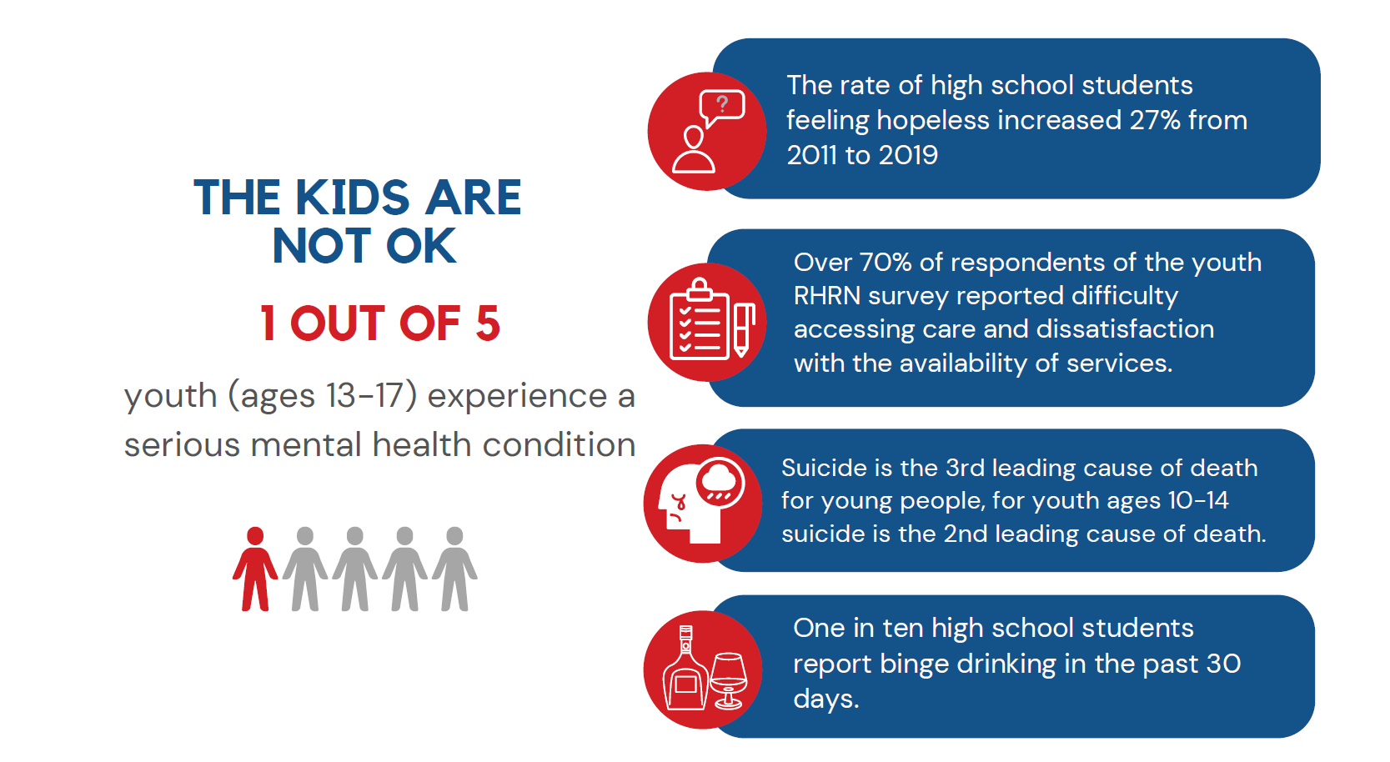

Slide 14
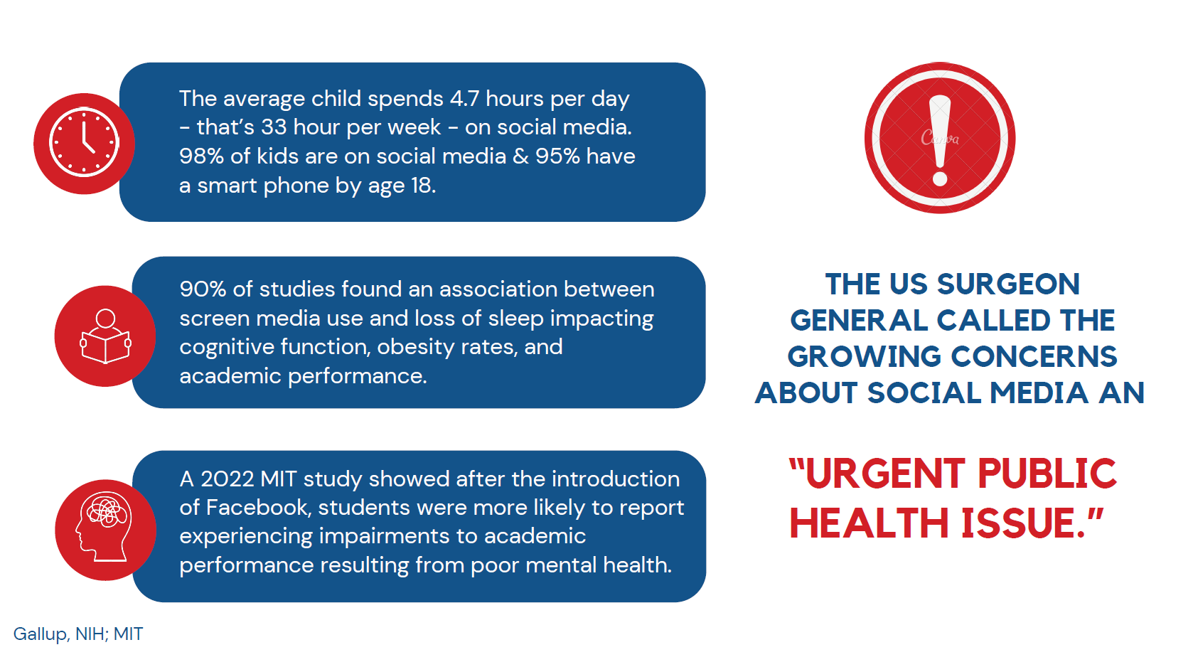

Slide 16
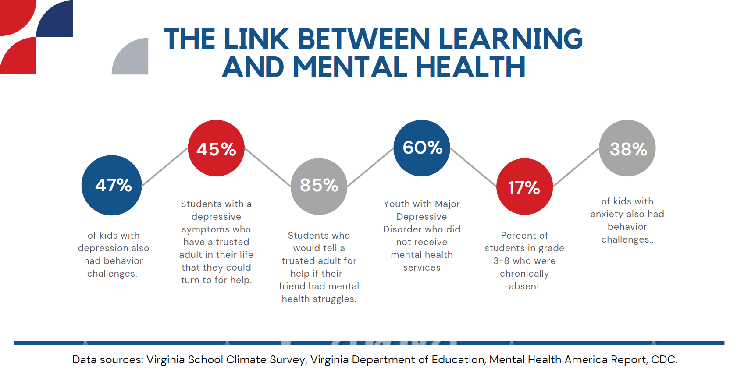

Slide 17
Youth with disabilities and co-occurring mental illness are disproportionately impacted
Co-occurring mental disorder in children and adolescents with ID/IDD are common and persistent across the lifespan.
Only 1 in 10 children and adolescents with co-occurring mental disorders receive specialized mental health services.
Co-occurring mental disorders in children and adolescents with ID/IDD are more predictive of major restrictions in educational and vocational participation and social inclusion than the severity of the ID/IDD.
Mental well-being of parents of young people with ID/ IDD is more strongly influenced by the severity of their children’s co-occurring mental disorder than by the severity of the children’s ID/IDD.
Munir ,K. Curr Opin Psychiatry. 2016 Mar; 29(2): 95–102.
Notes:
Targeted interventions and programs and policies that ensure receipt of mental health screening, care, and support services could help reduce mental distress among adults with disabilities.

Slide 18
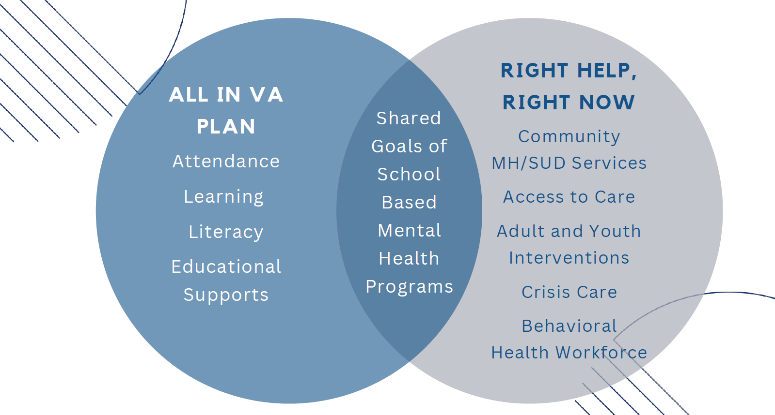

Slide 19
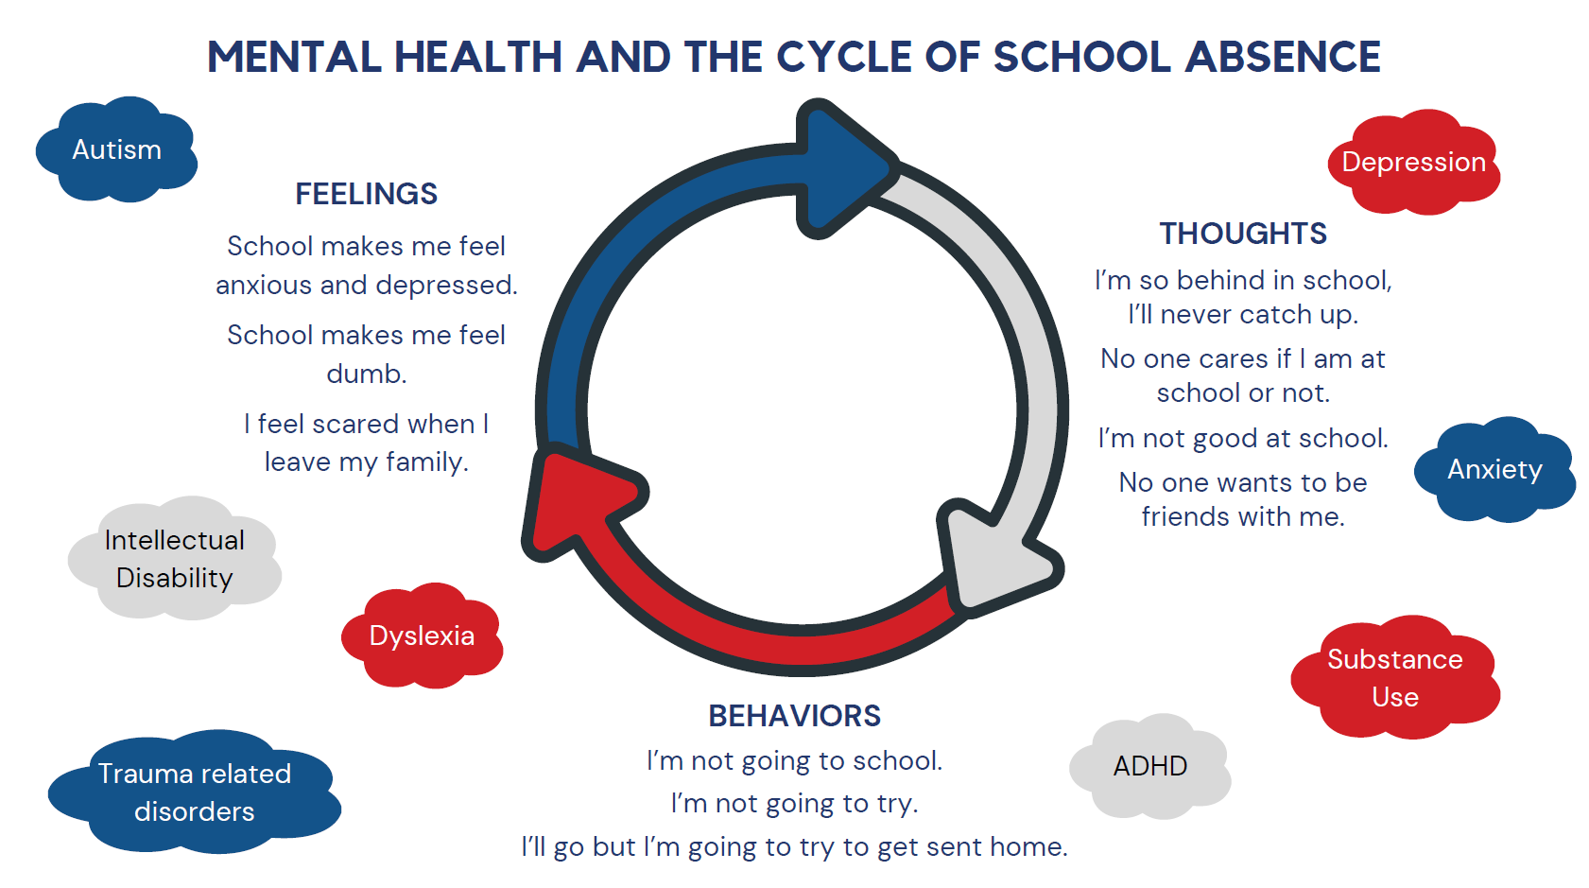

Slide 23
Looking forward
Targeted initiatives for youth mental health in the community, schools, and at home
Expanded public-private partnerships
Increased resources for schools and continued integration with the ALL In Virginia Plan
Addressing the impact on screen use and social media on youth mental health and school engagement
Efforts to expand and support the behavioral health workforce
Build out of community based services and integrated care

