Slide 1
VASS/VASBO WINTER CONFERENCE
SUPPORT CAP INFORMATION
]
JANUARY 10, 2022

Slide 2
STATE FUNDING REDUCTIONS FY 09-10
Support Cap 754,000,000
Construction Grants 55,000,000
Health Care Contribution 269,000,000
Eliminate SOQ Funding for Various Expenditures 244,000,000
Include $0 Values in Calculation 79,000,000
K-3 Class Size Cut 36,000,000
Bus Replacement Cycle (12 Yr. to 15 Yr.) 19,000,000
Inflation Update (some has been restored) 109,000,000
Cost Of Competing for N. Va. Support Positions 28,000,000
Increase Federal Deduct Percentage 34,000,000
BIENNIAL TOTAL $1,627,000,000
Notes:
THESE ARE THE REVENUE REDUCTIONS THAT HAVE CREATED OUR PROBLEMS.
AS YOU CAN SEE, THE SUPPORT CAP (LOCATED IN OUR BASIC AID) IS THE LARGEST REDUCTION AND WAS PRESENTED TO MEMBERS OF THE GENERAL ASSEMBLY AS SIMPLY REDUCING ADMINISTRATORS…NOT TRUE….MANY OTHER POSITIONS. WILL SHOW YOU LATER.
MANY OF THESE STILL EXIST…THE ONE I OFTEN USE AS AN EXAMPLE IS THE BUS REPLACEMENT SCHEDULE…CHANGED FROM 12 TO 15 POOF. WESTERN SCHOOL DIVISION BOUGHT BUSES FROM NORFOLK THAT WERE PUT ON AUCTION….HOPING TO GET A FEW MORE MILES FROM THEM.
NORFOLK SHOULD BE VERY CONCERNED ABOUT THE FEDERAL DEDUCT INCREASE IN PERCENTAGE…IT HIT YOU MORE THAN MOST.

Slide 3
Why Were The Cuts Made? Possibly Because of the Cost of Rebenchmarking
Biennium | Increase Over Previous Biennium
2006-2008 | $1.5 Billion
2008-2010 | $1.1 Billion
Impact of | Reductions
2010-2012 | $139 Million
2012-2014 | $312 Million
2014-2016 | $350 Million
2016-2018 | $387 Million
2018-2020 | $437 Million
2020-2022 | $491 Million
2022-2024 | $331 Million
Notes:
SO WHY WERE THE CUTS MADE TO PUBLIC EDUCATION?
THERE WAS A FINANCIAL CRISIS…..AND REVENUES HAD TO DECREASE…
BUT, THIS IS A PERSONAL OPINION THAT CANNOT BE VERIFIED BY FACTUAL INFORMATION, THE CONTINUING INCREASE IN THE REBENCHMARKING HAD BEEN A CONCERN AT THE STATE.
0608 BIENNIUM THE INCREASE WAS $1.5 BILLION
IN THE 08-10 BIENNIUM, IT WAS $1.1 BILLION
DRIVEN PRIMARILY BY SALARY INCREASES AND INCREASES DRIVEN BY PREVAILING COST METHODOLGIES SUCH AS SUPPORT POSITION CALCULATION….
PERHAPS SOME PERSONS SAW THE ECONOMIC DOWNTURN/RECESSION AS AN OPPORTUNITY TO ADJUST THE METHODOLOGY APPROVED WITH THE JLARC STUDIES OF THE LATE 1980’S
OVER 1 BILLION DOLLARS DECREASE FROM 06-08 TO 20-22. A BILLION DOLLARS IS A LOT OF MONEY.

Slide 4
Support Positions ^{1, 2}
Assistant Superintendent
Instructional Professional
Instructional Technical/Clerical
Attendance & Health Administrative
Attendance & Health Technical/Clerical
Administration Administrative
Administration Technical/Clerical
Technology Professional
Technology Technical/Clerical
Operation & Maintenance
Support Technology
School Based Clerical
Operation & Maintenance Technical/Clerical
Notes:
WHAT IS A SUPPORT POSITION ….THIS LIST IS TAKEN FROM THE CALC TABLES PROVIDED BY THE STATE. THESE DESIGNATIONS INCLUDE ALMOST ANYONE WHO IS NOT INCLUDED IN THE SOL APPROVED POSITIONS THAT ARE DRIVEN BY ENROLLMENT. IT SHOULD BE NOTED THAT THE STATE ADDED ANOTHER POSITION FOR THE 21-22 SCHOOL YEAR CALLED the Specialized Student Support positions. Those will be calculated on a 3 per 1000 standard. The positions include licensed and unlicensed nurses, social workers, psychologists, licensed behavior analysts, licensed assistant behavior analysts, and other licensed health and behavioral positions.

Slide 5
Support Cap Savings for the State Per Biennium
Shows number of SOQ funded positions per support position and the impact on the State Budget each biennium.
Note: Savings was lost revenue for schools moving forward.
09/10 4.03 (state budget savings (1 year) = $341 million)
10/12 4.05 (state budget savings = +$25.3million)
12/14 4.07 (state budget savings = + $15.9 million)
14/16 4.09 (state budget savings = + $6.1 million)
16/18 4.19 (state budget savings = + $25.3 million)
18/20 4.27 (state budget savings = +$18.9 million)
20/22 4.30 (state budget savings = +$3.34 million)
22/24 4.19 (state budget cost increase = -$34.7 million)
Notes:
OUR NUMBER ONE LEGISLATIVE PRIORITY IS THE RESTORATION OF FUNDING FOR SUPPORT POSITIONS…..THIS SHOWS WHAT HAS HAPPENED SINCE THE IMPLEMENTATION OF THE CAP..
EVERY BIENNIUM, THE “cap” GOES UP (NUMBER OF SOQ FUNDED POSITIONS FOR EVERY ONE SUPPORT POSITION…THAT SAVES THE STATE SIGNIFICANT DOLLARS WHEN THAT GOES UP.
SO THE LOSS IS NOT JUST WHAT WAS CUT IN 0910…BUT EVERY BIENNIUM SINCE THE CUT HAS INCREASED…AND THE DOLLARS OBVIOUSLY ACCUMULATE EXCEPT THIS COMING BIENNIUM. THE RATIO ACTUALLY DROPPED AND IT INCREASED THE STATE COST OR REVENUE TO SCHOOLS BY $34.7 MILLION. STATE DEPARTMENT OFFICIALS BELIEVE THE REASON FOR THE DROP IN THE RATIO WAS DUE TO THE LARGE NUMBER OF VACANCIES DURING THE PANDEMIC. THERE WAS ALSO SOME NEW POSITIONS ADDED TO THE CALCULATION AT A LOWER RATIO.
SO THAT IS A QUICK SUMMARY OF WHERE WE HAVE BEEN AND WHAT WE KNOW….
THE ORIGINAL LEGISLATION INDICATED THAT THE STATE SHOULD SHOW BOTH THE SUPPORT CAP CALCULATION AND THE “PREVAILING COST CALCULATION” THAT WAS USED PRIOR TO THE CHANGE, BUT YOU CANNOT SEE BOTH UNLESS YOU COPY THE CHART ON THE CALC TABLE AND PUT IT IN A BLANK EXCEL PAGE. I STRONGLY SUGGEST YOU HAVE YOUR FINANCE PERSONS DO THIS …IT SHOWS HOW MUCH MONEY (FUNDING FOR SUPPORT POSTIONS) YOU LOSE EACH YEAR.

Slide 6
Enrollment Increase Compared to Change in Total State Basic Aid 2009/2010 to 2022/2023
FY | ENROLLMENT | Total Basic Aid All Divisions
2009-2010 | 1,204,786 | $3,459,313,849
2022-2023 | 1,221,278 | $3,666,351,421
% Increase/Decrease | +1.37% | 5.98%
Notes:
THIS IS A LOOK AT ENROLLMENT CHANGES FOR THE PERIOD WE ARE EXAMINING.
THE TOTAL STATE BUDGET HAS GROWN AT A RATHER RAPIDE RATE, BUT BASIC AID HAS NOT.
MY JOB TODAY IS TO ASSIST YOU IN LETTING YOUR GENERAL ASSEMBLY MEMBERS KNOW WHAT HAS HAPPENED AND WHY THEY NEED TO MAKE SOME MAJOR CHANGES IN THE CALCULATION METHODOLOGY.
THIS IS NOT GOING TO BE EASY.

Slide 7
State General Fund Budget Increase Compared to Change in Total Basic Aid 2008/2009 to 2022/2023
FY | State General Fund Budget | Total Basic Aid All Divisions
2008-2009 | $14,315,060,000 | $3,459,313,849
2022-2023 | $30,068,135,192 | $3,666,351,421
% Increase/Decrease | +110.05% | +5.98%
Notes:
PERHAPS THIS IS AS FAR AS I NEED TO GO TO SHOW WHAT HAS HAPPENED TO PUBLIC SCHOOLS IN VIRGINIA IN THE PAST 12 YEARS
ON THE LEFT IS THE FISCAL YEAR…IN THE CENTER COLUMN IS THE TOTAL STATE GENERAL FUND BUDGET FOR 2008-2009 AND THEN 2022-23 based on the Governor’s proposed budget.
ON THE RIGHT YOU SEE THE BASIC AID TOTAL FOR ALL SCHOOL DIVISIONS IN VIRGINIA FOR THE SAME YEARS.
VERY SIMPLY, THE STATE GENERAL FUND BUDGET HAS INCREASED OVER 110% SINCE THE 0809 FY AND THE PAYMENTS TO PUBLIC SCHOOLS IN THE CATEGORY OF BASIC AID HAVE increased IN THE SAME PERIOD BY 5.98%. 14 years.
THERE ARE MANY OTHER THINGS THAT HAVE HAPPENED IN THOSE 10 YEARS, BUT BASIC AID INCLUDES THE STATE SHARE OF PAYMENTS FOR FUNDED TEACHERS, ADMINISTRATORS, GUIDANCE, LIBRARIANS AND OTHER POSITIONS SUCH AS THE SUPPORT POSITIONS NOTED IN AN EARLIER SLIDE.

Slide 8
SUPPORT POSITION CALCULATION USING CAP
 |  |  |  | Original FY 2021 ADM
SUPPORT CAP | FISCAL YEAR 2021 |  |  | 40,229.85
 | Funded Support Ratio | Prevailing Salary | SOQ Funded | Final FY 2021
Support Positions ^{1, 2} | Positions Per Pupil | Per Position | Support Positions | Total Salary Cost
Assistant Superintendent | 0.000135 | $122,862 | 5.43 | $ 699,999
Instructional Professional | 0.001814 | $71,492 | 72.94 | $ 5,474,076
Instructional Technical/Clerical | 0.001384 | $32,701 | 55.64 | $ 1,910,516
Attendance & Health Administrative | 0.000719 | $62,061 | 28.89 | $ 1,883,562
Attendance & Health Technical/Clerical | 0.000275 | $31,043 | 11.06 | $ 360,459
Administration Administrative | 0.000599 | $81,176 | 24.10 | $ 2,052,527
Administration Technical/Clerical | 0.001193 | $43,740 | 47.95 | $ 2,202,584
Technology Professional | 0.000383 | $78,624 | 15.41 | $ 1,270,861
Technology Technical/Clerical | 0.000125 | $37,375 | 5.03 | $ 197,126
Operation & Maintenance | 0.000218 | $77,590 | 8.77 | $ 714,080
Support Technology | 0.001000 | $49,145 | 40.19 | $ 2,074,251
School Based Clerical | 0.003035 | $30,723 | 122.02 | $ 3,935,686
Operation & Maintenance Technical/Clerical | 0.006460 | $30,942 | 259.68 | $ 8,437,004
Fiscal Year 2021 SOQ Funded Support Positions: |  |  | 697.11 | $ 31,212,731
Support Position Cost per pupil amount is a portion of the year 1 Basic Aid per pupil amount: |  |  |  | $ 776
Notes:
THIS SLIDE SHOWS THE SUPPORT CAP CALCULATION FOR CHESAPEAKE PUBLIC SCHOOLS FOR THE 2021 SCHOOL YEAR. THE RED NUMBERS ARE THE KEY. ENRO..MENT, TOTAL SUPPORT POSITIONS, TOTAL SALARY FOR FUNDED SUPPORT POSITIONS, AND THE PER PUPIL AMOUNT FOR SUPPORT POSITIONS.

Slide 9
SUPPORT POSITION CALCULATION USING PREVAILING COST METHODOLOGY
PREVAILING CALCULATION |  |  |  | Original FY 2021 ADM
 | FISCAL YEAR 2021 |  |  | 40,229.85
 | Prevailing Support | Prevailing Salary | SOQ Funded | Final FY 2021
Prevailing Support Positions¹ | Positions Per Pupil | Per Position | Support Positions | Total Salary Cost
Assistant Superintendent | 0.000217 | $122,862 | 8.73 | $ 1,125,229
Instructional Professional | 0.002918 | $71,492 | 117.31 | $ 8,805,510
Instructional Technical/Clerical | 0.002227 | $32,701 | 89.51 | $ 3,073,963
Attendance & Health Administrative | 0.001157 | $62,061 | 46.51 | $ 3,030,917
Attendance & Health Technical/Clerical | 0.000443 | $31,043 | 17.82 | $ 580,517
Administration Administrative | 0.000963 | $81,176 | 38.70 | $ 3,299,652
Administration Technical/Clerical | 0.001920 | $43,740 | 77.20 | $ 3,544,652
Technology Professional | 0.000616 | $78,624 | 24.78 | $ 2,044,481
Technology Technical/Clerical | 0.000201 | $37,375 | 8.09 | $ 317,011
Operation & Maintenance | 0.000351 | $77,590 | 14.12 | $ 1,149,367
Support Technology | 0.001000 | $49,145 | 40.19 | $ 2,074,251
School Based Clerical | 0.004882 | $30,723 | 196.24 | $ 6,330,971
Operation & Maintenance Technical/Clerical | 0.010393 | $30,942 | 417.79 | $ 13,573,954
Fiscal Year 2011 SOQ Funded Support Positions: |  |  | 1,096.99 | $ 48,950,475
Support Position Cost per pupil amount is a portion of the year 1 Basic Aid per pupil amount: |  |  |  | $ 1,217
Notes:
THIS SLIDE SHOWS THE SAME CALCULATION , AGAIN FOR CHESAPEAKE, USING THE PREVAILING COST CALCULATION THAT WAS USED PRIOR TO 2009-2010.
I MENTIONED EARLIER HOW TO GET TO THIS FROM THE STATE CALC TABLE BUT YOU CAN CONTACT ME FOR THIS. MOST OF YOU HAVE MY EMAIL ADDRESS, BUT VASS CERTAINLY CAN PROVIDED IT.

Slide 10
Calculation of Loss for 2023
CHESAPEAKE PUBLIC SCHOOLS
 | PREVAILING | SUPPORT CAP | DIFFERENCE
POSITIONS | 1052.58 | 829.37 | (223.21)
COST PER PUPIL | 1268 | 1011 | (257)
FUNDED SALARY | $ 50,665,097 | $ 40,406,234 | $ (10,258,863)
 |  | COMPOSITE INDEX | 0.3409
 |  | LOCAL SHARE | $ (3,497,246.40)
LOSS OF STATE REVENUE 2021 |  | STATE SHARE | $ (6,761,616.50)
Notes:
TO SHOW YOU HOW YOU CAN CALCULATE THE LOSS FOR EACH YEAR FOR YOUR SCHOOL DIVISION BASED ON THE IMPACT OF THE SUPPORT CAP, FOLLOW THE STEPS SHOWN HER TO CALCULATE THE LOSS FOR CHESAPEAKE FOR 2023……OVER 6.7 MILLION DOLLARS. WHILE IT WOULD INCREASE THE LOCAL REQUIRED CONTRIBUTION, MOST ALL SCHOOL DIVISIONS ARE WELL OVER THE REQUIRED AMOUNT.
THERE WOULD BE NO REQUIREMENT FOR ANY NEW POSITIONS, ETC. AND REMEMBER….THIS IS FOR ONE YEAR. IN CHESAPEAKE, THIS ALONE WOULD HAVE FUNDED BETWEEN A 2 AND 3 PERCENT INCREASE IN ALL SALARIES FOR THIS YEAR.

Slide 11
Calculation of Loss for 2021
CHESAPEAKE PUBLIC SCHOOLS
 | PREVAILING | SUPPORT CAP | DIFFERENCE
POSITIONS | 1096.99 | 697.11 | (399.88)
COST PER PUPIL | 1217 | 776 | (441.00)
FUNDED SALARY | $ 48,950,475.00 | $ 31,212,731.00 | $ (17,737,744.00)
 |  | COMPOSITE INDEX | 0.3486
 |  | LOCAL SHARE | $ (6,183,377.56)
LOSS OF STATE REVENUE 2021 |  | STATE SHARE | $ (11,554,366.44)
Notes:
THIS IS THE SAME CALCULATION FOR 2021….AS YOU CAN SEE, THERE IS AN INCREASED LOSS OF OVER 5 MILLION DOLLARS….I DID SOME INVESTIGATION OF THIS CHANGE AND IT IS PROBABLY DUE TO THE LOWER CAP PERCENTAGE (4.30 TO 4.19) AND THE INCREASE IN THE NUMBER OF POSITIONS FUNDED IN THE CAP….BUT I CANNOT TELL THE IMPACT OF MOVING THE POSITIONS FROM WHERE THEY WERE FUNDED PRIOR.

Slide 12
Eliminating the Support Cap

Slide 13
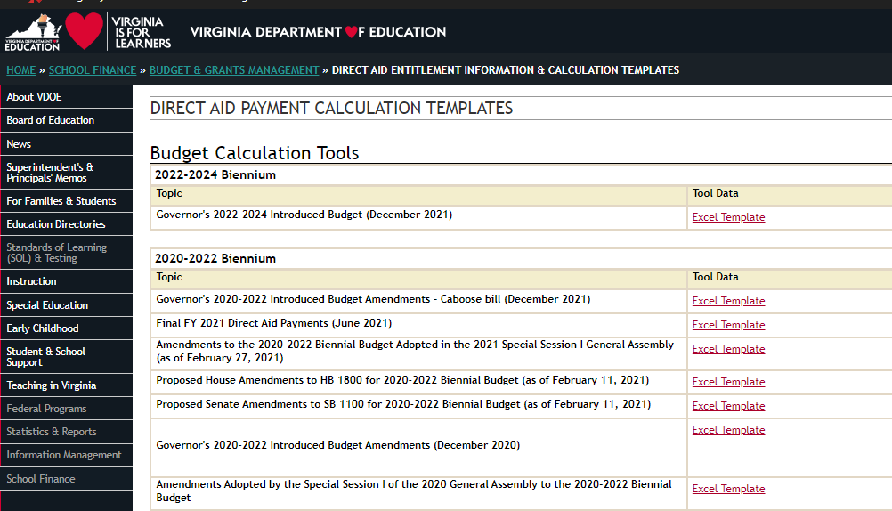
Virginia Department of Education
Virginia Department of Education website publishes the Support Cap payments under their biennium Direct Aid Payment. For example, this years is covered in the 2020-2022 Biennium Section.
The Excel Template linked will provide the document you need to see what your divisions allocations are.

Slide 14
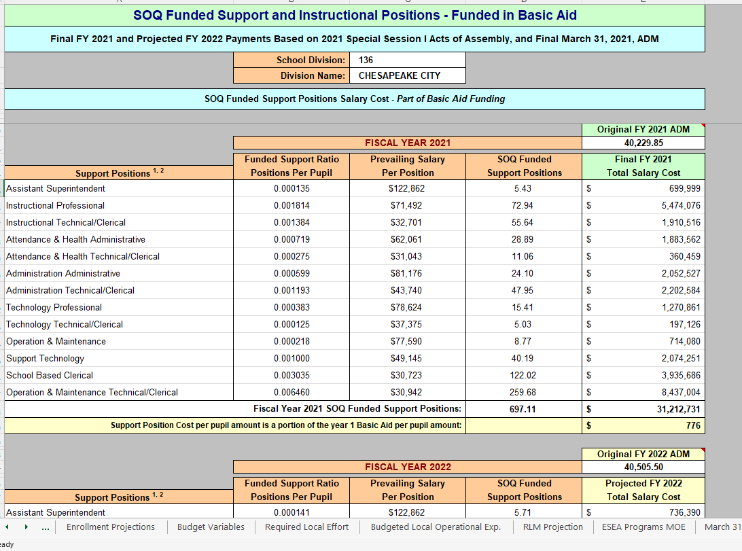
Direct Aid Payments
The document highlights many different data sources, calculations, and elements of interest within the financing of the divisions within the Commonwealth.
Concerning the Support Cap, the information can be found under the Funded Positions tab. This will show both years included in the document and shows the calculations behind the financial support provided to the divisions.
Since its inception in 2011, the Support Cap has defined the state’s suggestion on necessary position count of certain administrative, instructional and support staff members. However, it has not been without controversy, as divisions find the need to hire positions not provided by the state and end up paying for these “out of pocket”.

Slide 15
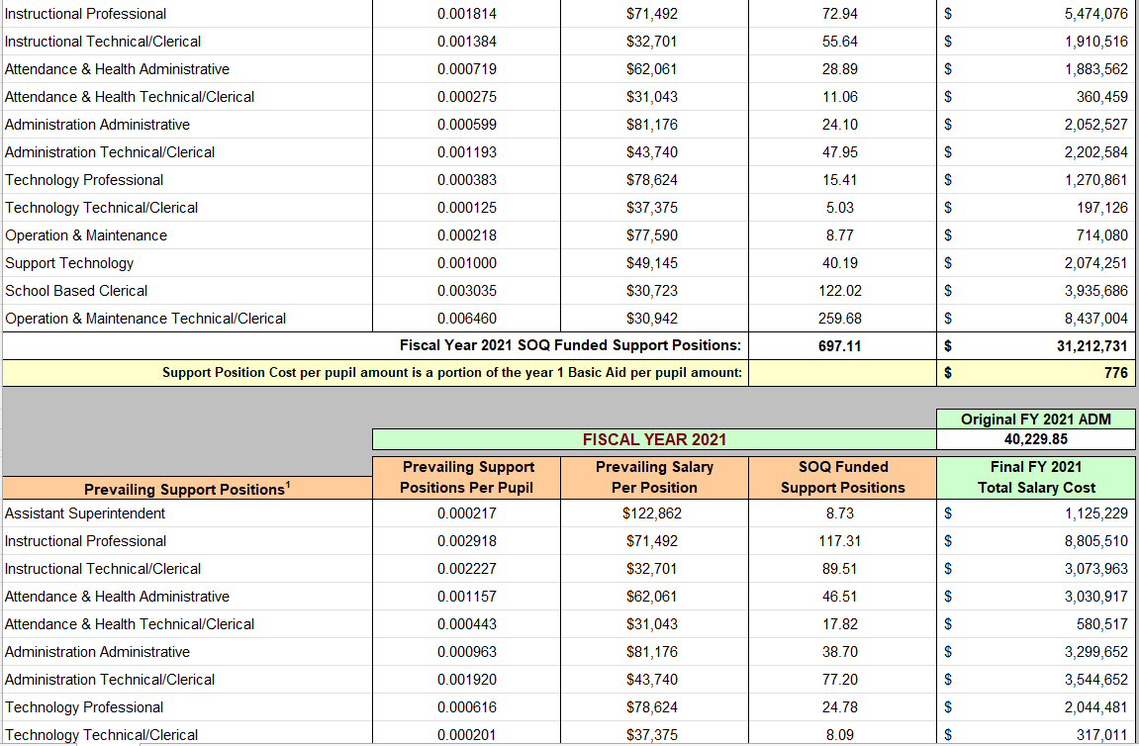
Direct Aid Payments
Together with Jim Roberts, and with the support of VASS, VASBO & VSBA, Forecast5 Analytics developed a new visual surrounding the Support Cap and the information it contains.
The same document highlighted previously encompasses a series of hidden rows – rows which contain the numbers associated with calculation's using the Prevailing support and wage information. It shows the number of positions, and the salaries funded, if the Support Cap had not been permitted a decade ago. In lay man’s terms, it shows the dollar figure that the division could have received to support necessary positions but was withheld by the state.

Slide 16
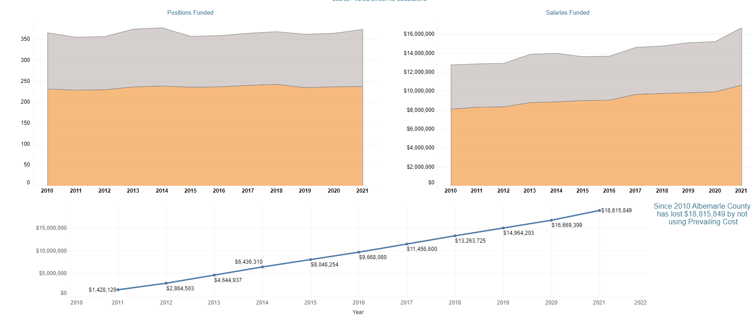
SOQ Support Position Loss
The Support Cap visual above, now included in the 5Sight tool, will show a division, with just one click, the position number and dollar figure that the division has missed over the last 11 years, along with the total financial impact to the division can be seen. In addition, a division can review that of their peers as well.
This will help a division to see the consequences of the Support Cap versus Prevailing Wage, its impact on the finances of the division, and most importantly, the impact on the students as staff counts have been lower. Especially in this current environment of quarantined teachers, ill teachers, and in some cases, a return to a virtual environment, students can benefit more than ever from a more robust group of educators.

