Slide 1
School- Based Health Centers
Presider/Moderator: Dr. Chip Jones, Cumberland County Superintendent​
Panelists:​
Dr. Susan Tilley, Galax City School Superintendent ​
Dr. Amy Cashwell, Henrico County Schools Superintendent ​
Dr. Melody Hackney, Hopewell City Schools Superintendent ​
Dr. Shannon Grimsley, Rappahannock County Schools Superintendent​
​

Slide 2
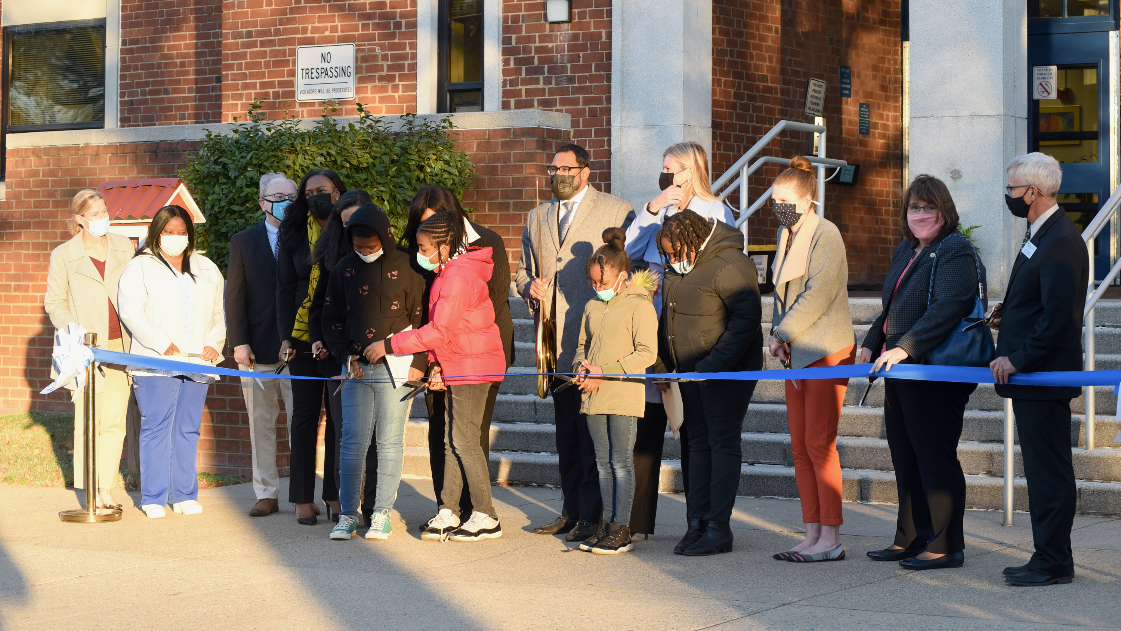

Slide 3
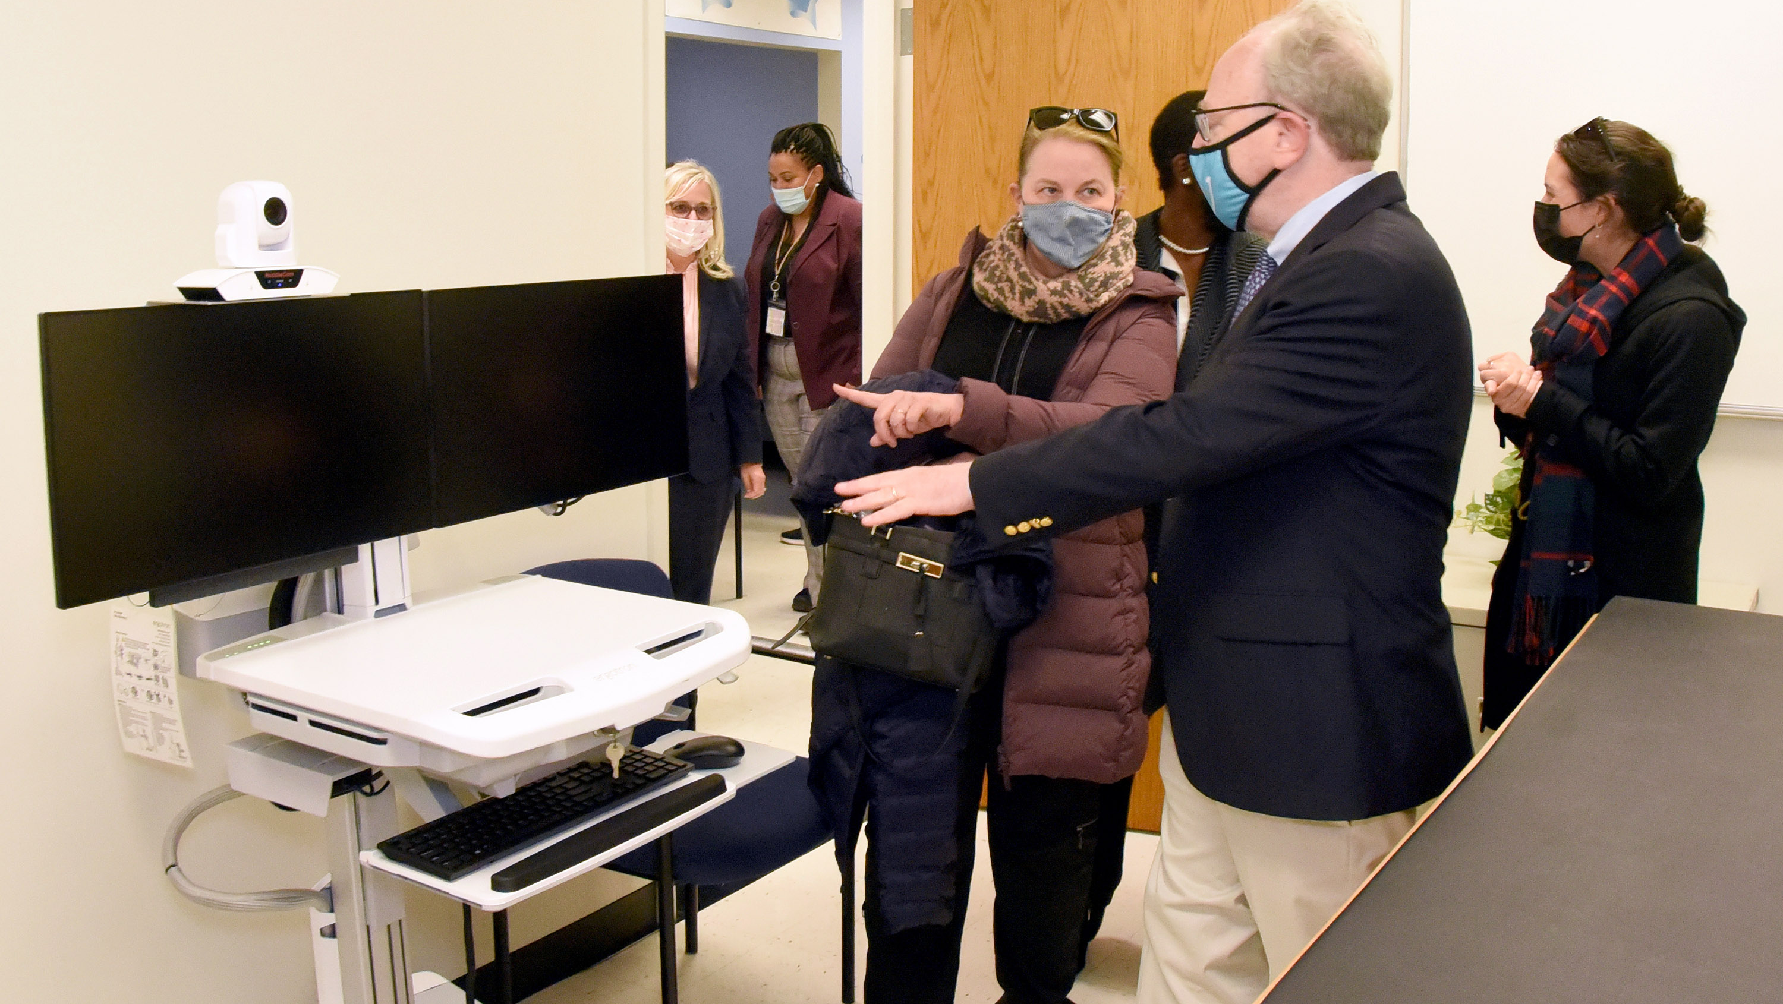

Slide 4
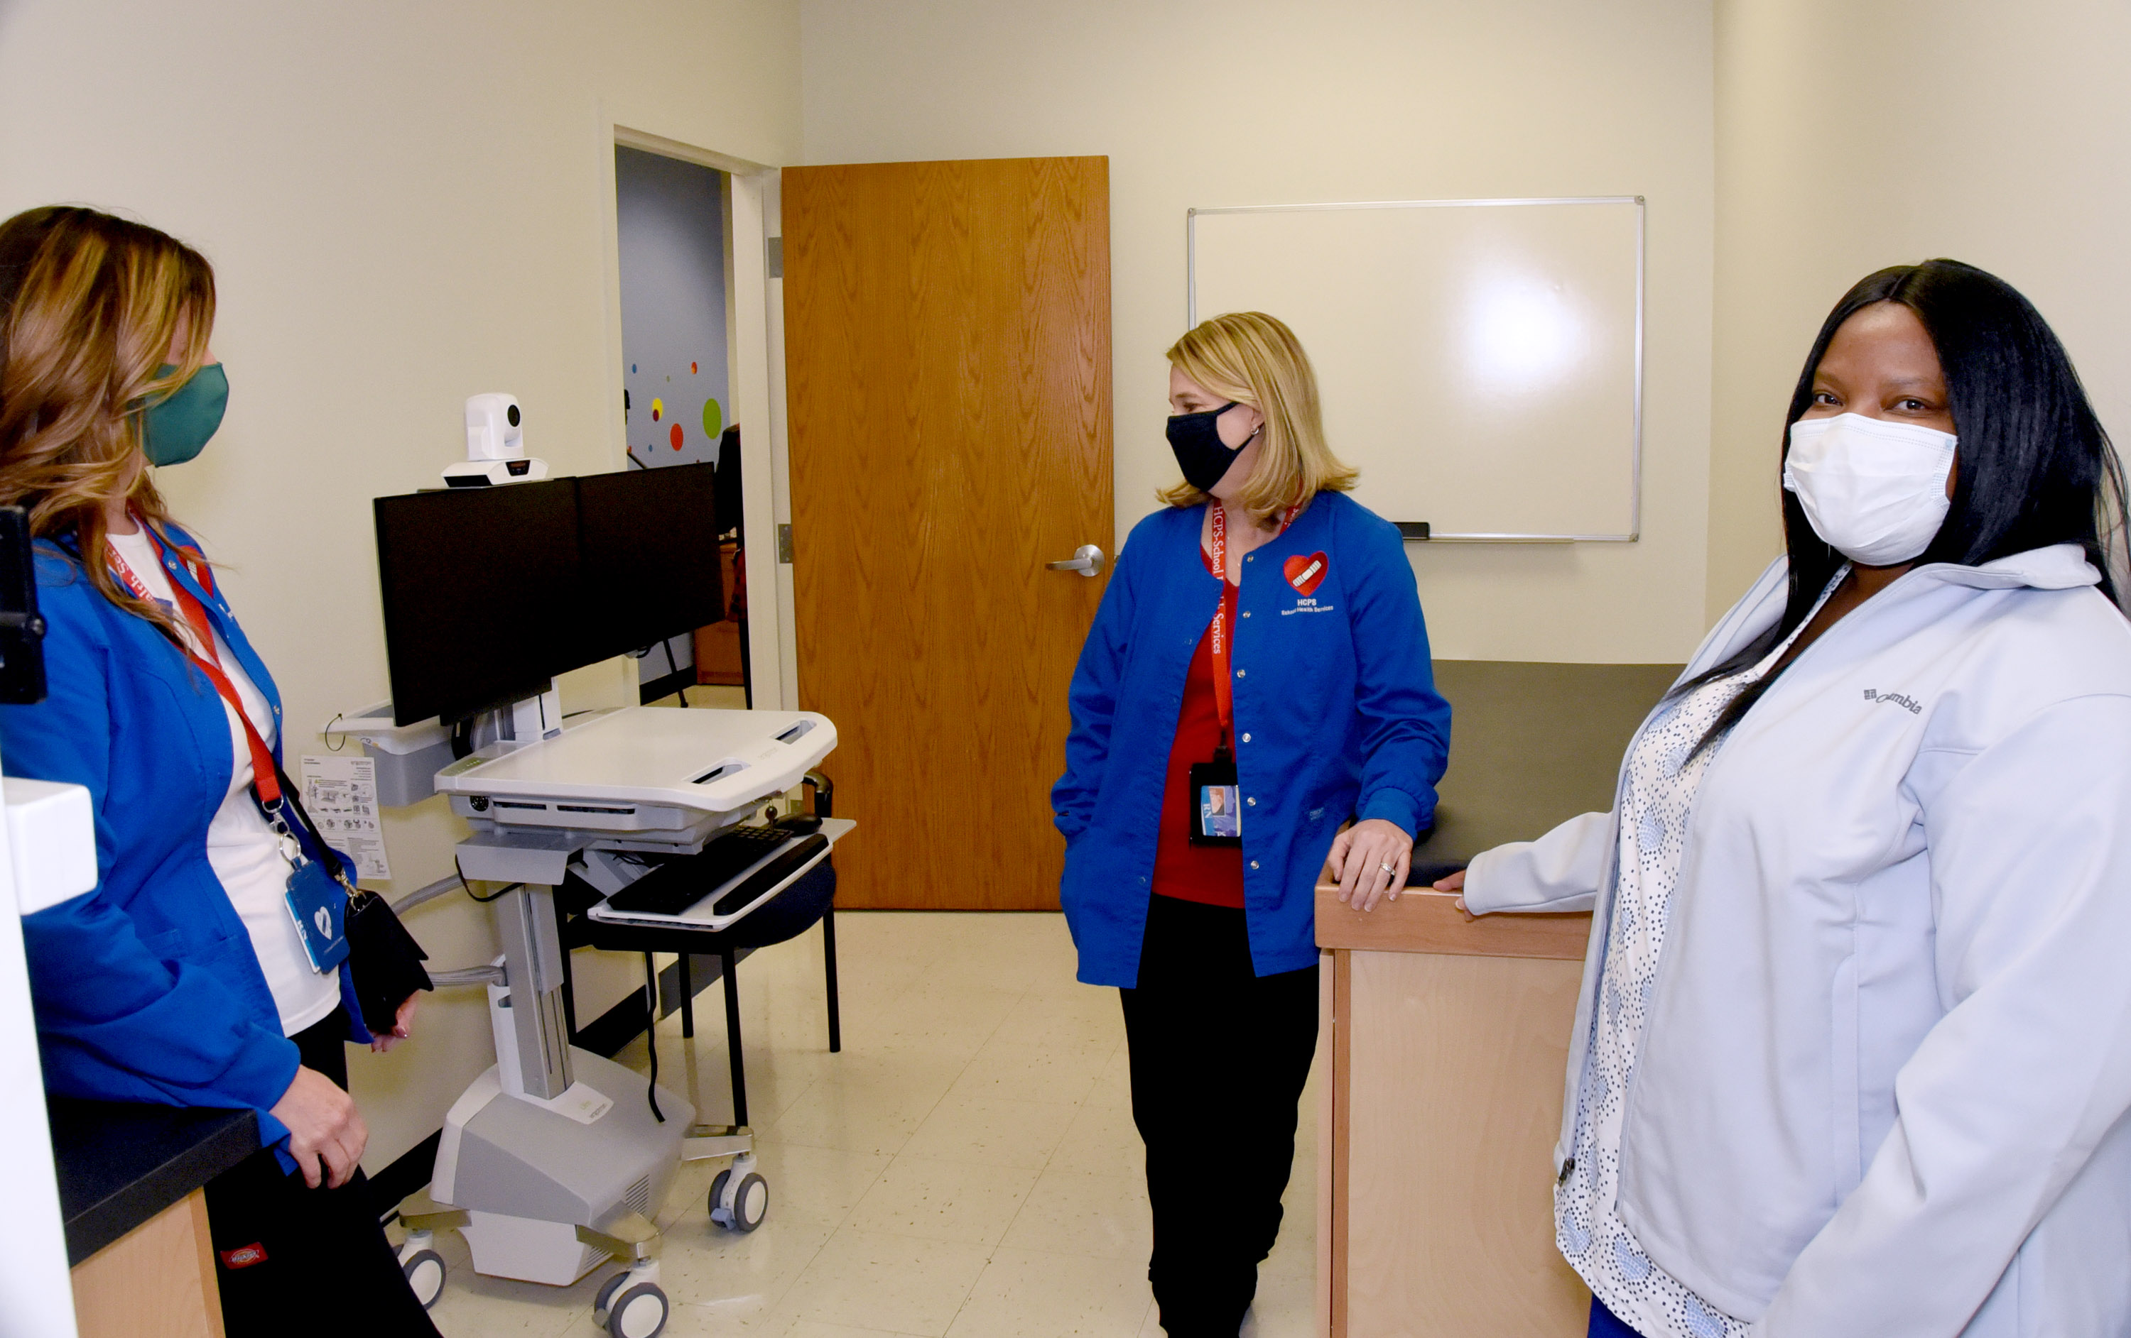

Slide 5
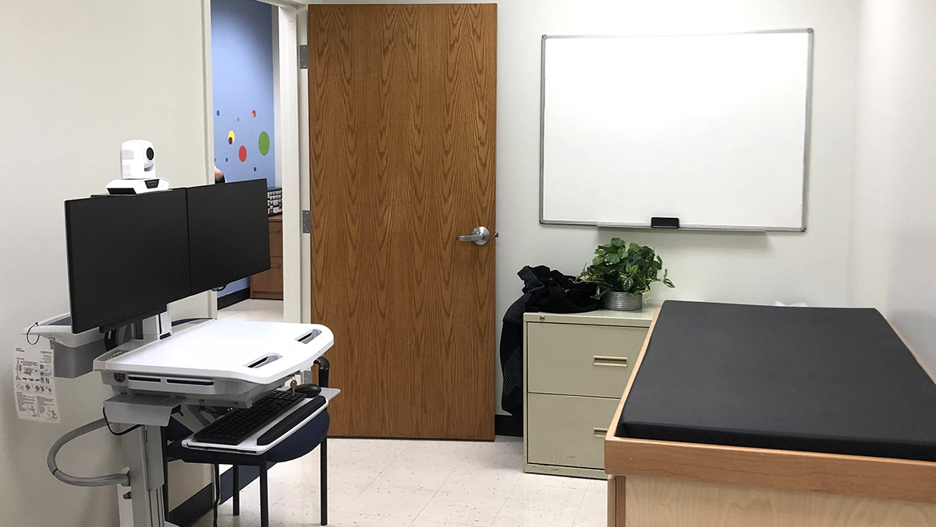

Slide 6
